Slide 1
Drugs affecting the autonomic nervous system

Slide 2
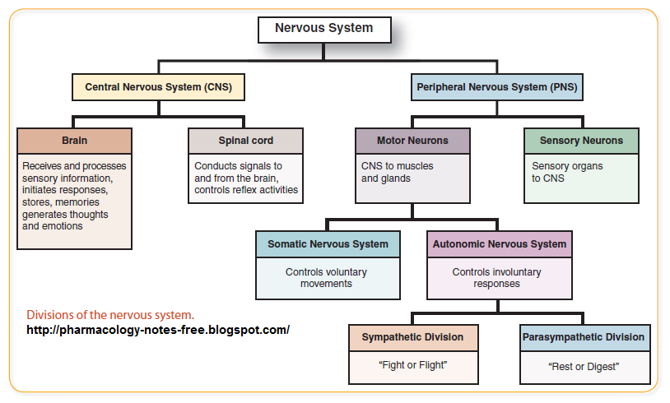

Slide 3
Autonomic drugs: are drugs that produce their primary therapeutic effect by mimicking or altering the functions of the ANS.
Autonomic drugs are useful in many clinical conditions.

Slide 4
Two major motor (efferent) subdivisions: autonomic and somatic.
Activities of the ans are not under direct conscious control.
Ans control visceral functions such as cardiac output, blood flow to various organs, and digestion, which are necessary for life.
The somatic subdivision control conscious functions such as movement, respiration.

Slide 5
Both systems have important afferent (sensory) inputs that provide information regarding the internal and external environments and modify motor output through reflex arcs of varying size and complexity.
These autonomic drugs act either by stimulating or by blocking the action of the autonomic nerves.

Slide 6
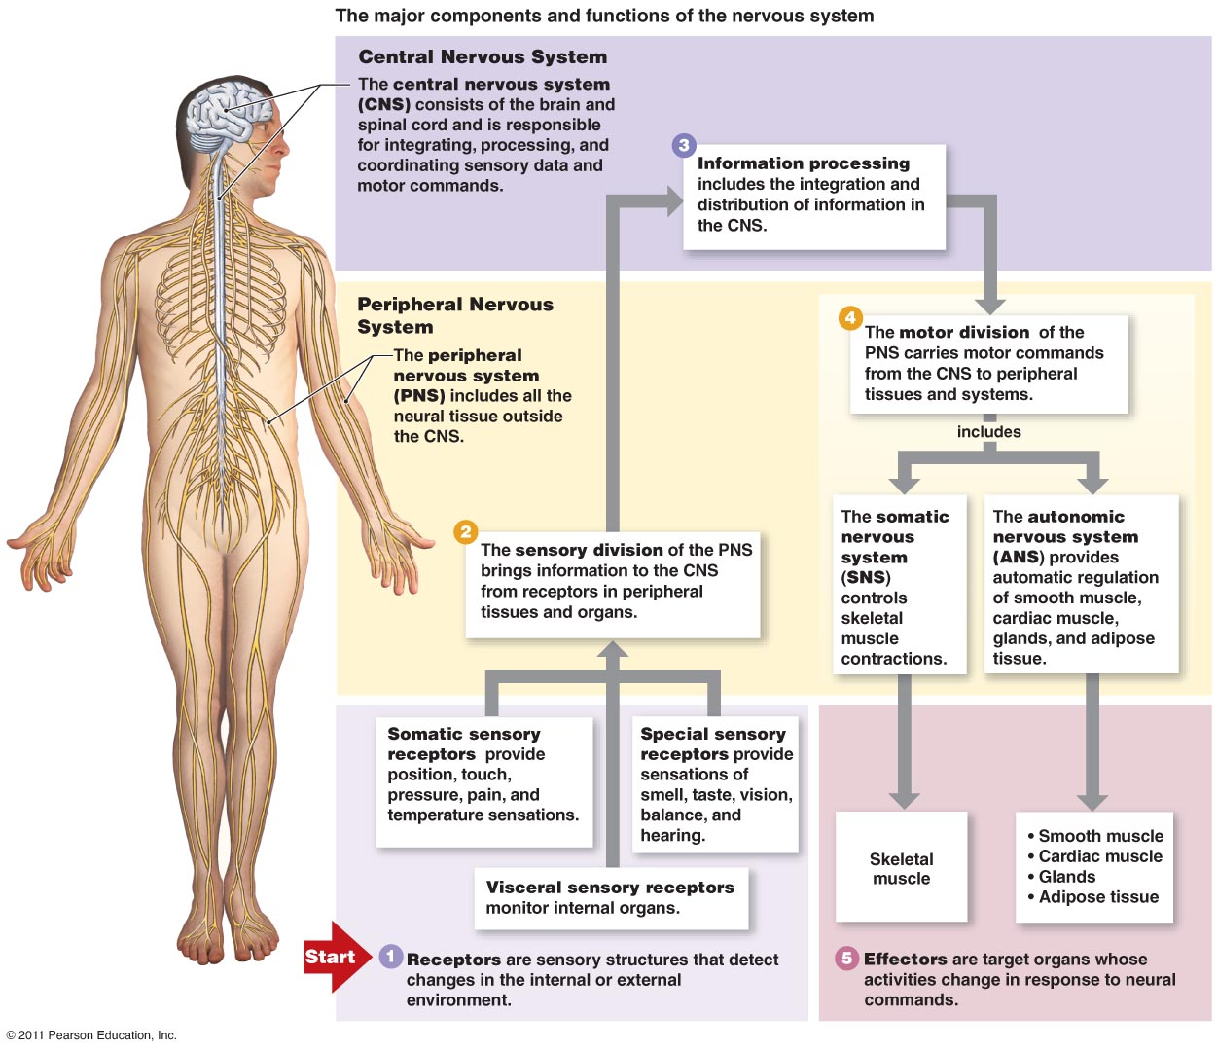

Slide 7
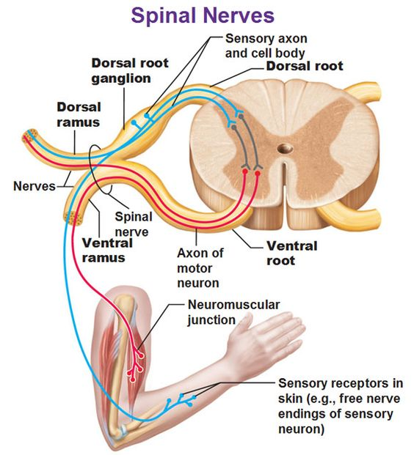

Slide 8
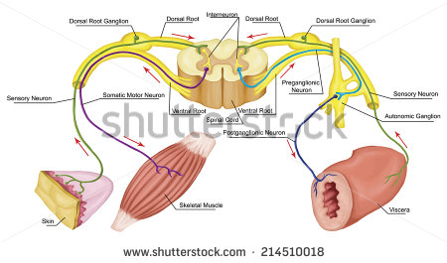

Slide 9
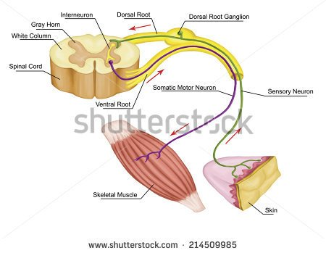

Slide 10
Anatomy of the ANS
ANS divided into the sympathetic division and the parasympathetic division.
Neurons originate in nuclei within the CNS and give rise to preganglionic efferent fibers that exit from the brain stem or spinal cord and terminate in motor ganglia.

Slide 11
Sympathetic division
short sympathetic preganglionic fibers and synapse in two chains of ganglia near to and parallel on each side of the spinal cord.
Axons of the postganglionic neuron extend from these ganglia to the tissues that they innervate and regulate.

Slide 12
the preganglionic nerve endings are branched, enabling one preganglionic neuron to interact with many postganglionic neurons causing activation of numerous effector organs at the same time.
The adrenal medulla, in response to stimulation by acetylcholine, secretes epinephrine, and lesser amounts of norepinephrine into the blood.

Slide 13
Parasympathetic division
parasympathetic preganglionic fibers terminate on ganglion cells distributed near or in the walls of the innervated organs.
Some parasympathetic ganglia located outside the innervated: the submandibular, otic ganglia.

Slide 14
the preganglionic fibers are long, and the postganglionic ones are short.
In most instances, there is a one-to-one connection between the preganglionic and postganglionic neurons, enabling discrete response of this system.

Slide 15
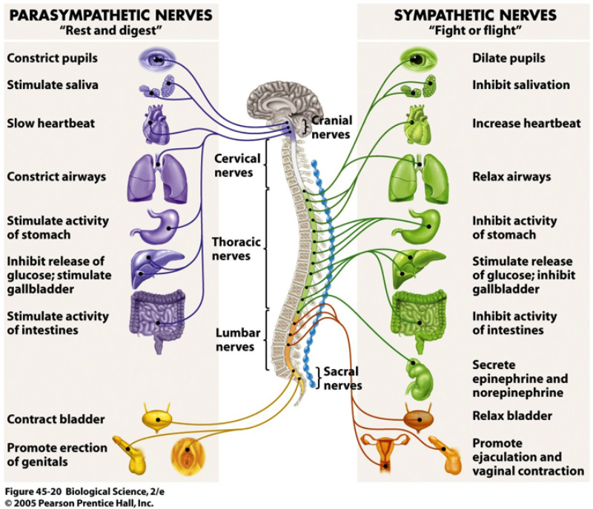

Slide 16
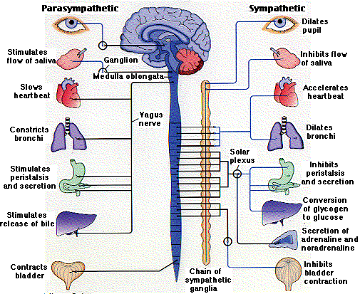

Slide 17
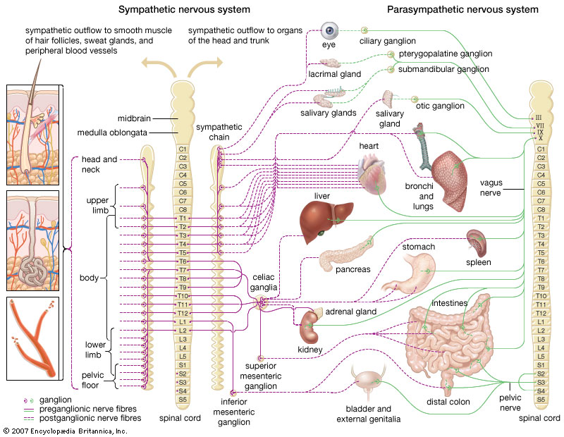

Slide 18
afferent fibers run from the periphery to integrating centers in the CNS.
the sensory pathways terminate in the integrating centers of the hypothalamus and medulla and evoke reflex motor activity that is carried to the effector cells by the efferent fibers of the sympathetic and parasympathetic divisions.

Slide 19
Functions of the sympathetic functions
response to stressful situations as trauma, fear, hypoglycemia, cold, and exercise.
increase heart rate and blood pressure, mobilize energy stores of the body, and to increase blood flow to skeletal muscles and the heart while diverting flow from the skin and internal organs.

Slide 20
sympathetic nervous system tends to function as a unit and often discharges as a complete system, for Ex. during severe exercise or in reactions to fear.
emergencies “fight or flight” response. These reactions are triggered both by direct sympathetic activation of the effector organs and by stimulation of the adrenal medulla to release epinephrine.

Slide 21
Functions of the parasympathetic nervous system
it maintains essential bodily functions, such as digestion and elimination of wastes.
it acts to oppose or balance the actions of the sympathetic division and generally predominates the sympathetic system in “rest-and-digest” situations.

Slide 22
the parasympathetic system never discharges as a complete system.
parasympathetic fibers innervating specific organs such as the gut, heart, or eye are activated separately, and the system functions to affect these organs individually.

Slide 23
Somatic nervous system
somatic neuron originating in the CNS, travels directly to skeletal muscle without the mediation of ganglia.
under voluntary control, whereas the ANS is involuntary.
somatic responses are faster than those in the ANS.

Slide 24
ANS neurotransmitters
cholinergic fibers: they work by releasing acetylcholine.
noradrenergic fibers: they work by releasing norepinephrine (noradrenaline).

Slide 25
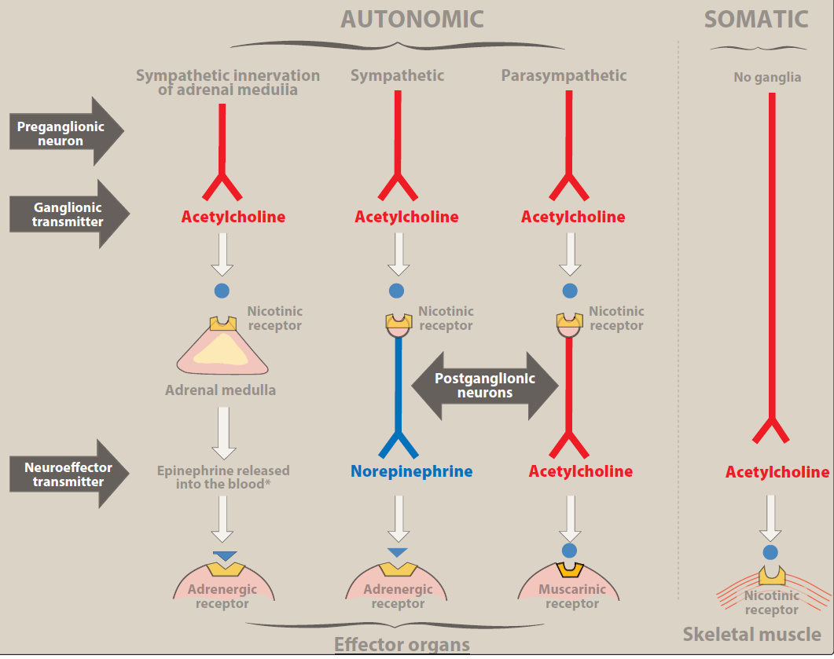

Slide 26
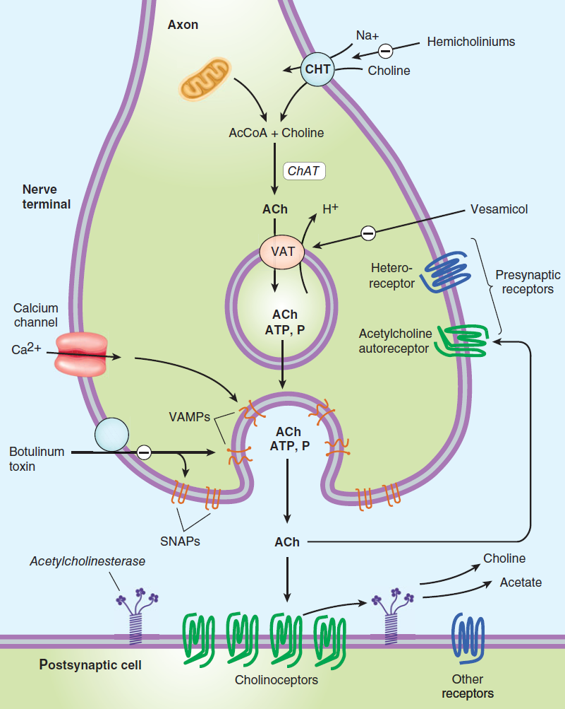
Cholinergic transmission

