Slide 1
Mechanical Properties of Polymer
Among various properties, the mechanical behaviour of polymers is of primary importance in determining their application. Polymers are not only subjected to applied mechanical forces during their lifetime but they may also be subjected to deformation during processing e.g. moulding of thermosets. It is therefore very important to know how a material will respond to an applied force.
From a practical point of view, we may be interested to know:
How stiff is a material? Can it be easily deformed?
How strong is it? What level of stress can we apply before breaking?
Does the material break easily on impact?

Slide 2
Mechanical Properties of Polymer
Similarly to metals, the mechanical properties of polymers are temperature dependent. However, as we will discuss in the sections dedicated to viscoelasticity, for polymers, time also plays an important role. It is therefore necessary to know how a polymeric material will respond when a load is applied for a length of time. We will see that polymers "creep" i.e. they deform irreversibly under constant load.

Slide 3
Mechanical Properties of Polymer
One of the parameters used to characterize the mechanical behaviour of a material is the resistance to deformation. However, there may be different ways in which we could possibly deform a specimen. Thus, if we consider the strength of a material we may wish to distinguish between:
tensile strength i.e. the resistance to stretching
compressional strength i.e. the resistance to compression
flexural strength i.e. the resistance to breaking when bent
impact strength i.e. how well the material will withstand the sudden application of stress, as when subjected to a hammer blow
In this brief discussion of the mechanical properties of polymers we will only consider the material's response under tension. This will serve to distinguish between plastics, fibers and elastomers.

Slide 4
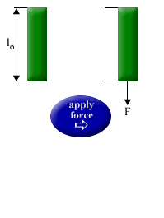
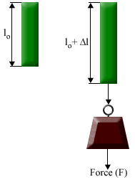
Mechanical Properties of Polymer
The mechanical behaviour is characterised in terms of stress-strain measurements. To define stress and strain, we consider measurements under tension i.e. we apply a force F to stretch a sample and we measure the deformation.

Slide 5
Mechanical Properties of Polymer
The stress, σ, is defined as
σ = F / A
where A is the cross sectional area.
Under the influence of the tensile force F, the material elongates. The resultant elongation i.e. the strain ε is defined as
ε = Δl / l₀
whereΔ l is change in length and l₀ is the original length of the specimen. Stress and strain allow us to compare the properties of different materials as these quantities are independent of the characteristics of the specimen (cross sectional area and length). (You should note that the specimen will deform also in the direction perpendicular to the stretching but, for the purpose of our discussion here, this can be neglected).
The stress is usually expressed in megapascals (1 N/ m² = 1 Pa, 1 MPa = 10⁶ Pa) whereas the strain is by definition a dimensionless quantity.

Slide 6
Mechanical Properties of Polymer
The deformation or strain depends on the magnitude of the applied stress. The stress-strain behaviour of metals under the influence of a tensile force is defined in terms of Hooke's law (at low applied stress)
σ = E ԑ
which indicates that stress is proportional to strain. A solid that obeys Hooke's law is said to be elastic.
The proportionality constant E is the modulus of elasticity or Young's modulus. Since the strain ԑ is a dimensionless quantity, the modulus E has the same units as stress σ.
The modulus gives a measure of a material's resistance to deformation. Obviously, high values of the Young's modulus are associated with high resistance to deformation.

Slide 7
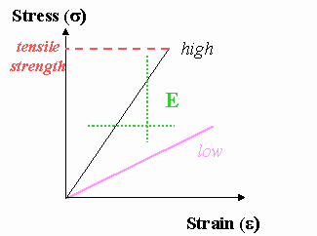
Mechanical Properties of Polymer
For metals, Young's modulus varies between 45 and 400 GPa (1 GPa = 10⁹ N/m² = 10³MPa); the stiffer the material, the higher is the modulus. Among polymeric materials, fibers have the highest tensile moduli.

Slide 8
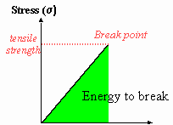
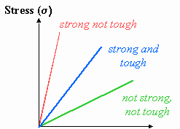
Mechanical Properties of Polymer
The stress-strain curve shown above provides other important information on the mechanical response of a material, in addition to Young's modulus. The ultimate strength or tensile strength is defined as the stress that is required to break the material. This value of stress gives a measure of the material's strength.
The area under the stress-strain curve highlighted below is a measure of the total energy that a material is able to absorb before breaking. This is related to the material's toughness.

Slide 9
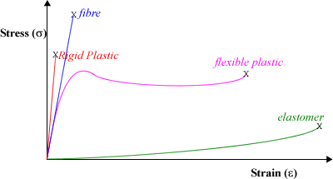
Mechanical Properties of Polymer
Strength and toughness are not correlated and therefore a material that is strong is not necessarily tough. Materials that deform little before breaking are said to be brittle e.g.plastics such as polystyrene are brittle.
Polymers may show different types of stress-strain behaviour and, according to the stress-strain curve, we may distinguish between
rigid and flexible plastics
fibres
elastomers

Slide 10
Mechanical Properties of Polymer-Rigid Plastic
The behaviour of rigid plastics and fibers is similar as they both show high resistance to deformation.
Rigid plastics have high moduli (up to ca. 4 GPa) and moderate to high tensile strength. Unlike flexible plastics, rigid materials do not elongate much before breaking (less than 1 to 3%) and are therefore brittle. This stress-strain behaviour is characteristic of amorphous or semicrystalline polymers at temperatures below the glass transition. Materials such as polystyrene and poly(methyl methacrylate) which have high T_{g}s behave as rigid plastics.

Slide 11
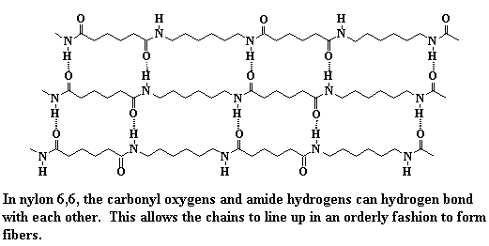
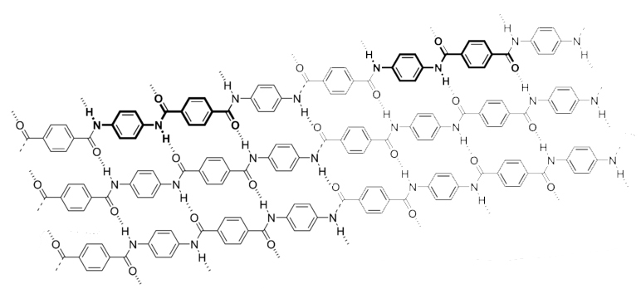
Mechanical Properties of Polymer - Fiber
Similarly to rigid plastics, fibers such as nylons and Kevlar have high resistance to deformation.

Slide 12
Mechanical Properties of Polymer
Fibers also present very high moduli and higher tensile strength compared to rigid plastics. Materials that form fibers are highly crystalline due to strong intermolecular forces between the molecules e.g. polar forces or hydrogen bonding in polyamides. Mechanical stretching (a process called drawing) is used to obtain highly oriented fibers whereby chains are oriented in the direction of stretching. The orientation of the crystalline structure leads to fibers that high strength and low elongation.

Slide 13
Mechanical Properties of Polymer-Flexible Plastic
Flexible plastics have moderate to high moduli and tensile strengths. The main feature of flexible plastics is the large ultimate elongation (up to 800%). Polyethylene and polypropylene are examples of flexible plastics as they are able to deform considerably before breaking. In general, flexible plastics are semi-crystalline polymers whose amorphous regions are above the glass transition temperature. As shown above, at small deformations, flexible plastics behave in an elastic manner i.e. the deformation is reversible. However, at higher elongation, the deformation becomes permanent. In this respect, flexible plastics differ considerably from elastomers, as the latter regain the original shape once stress is removed.

Slide 14
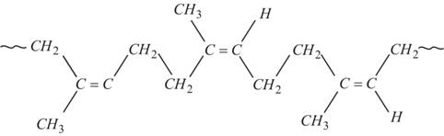
Mechanical Properties of Polymer-Elastomer
Elastomers such as polyisoprene and polybutadiene have very low moduli and for this reason can be easily deformed under the influence of relatively low stresses. Elongations up to 500 to 1000% can be achieved and the original shape is recovered once stress is removed i.e. the behaviour is elastic. Flexible polymers with low glass transition temperature (below the working temperature) and whose chains are capable of being cross-linked, may form elastomers. The degree of cross-linking needs to be low as highly cross-linked materials give rigid polymers with low deformability.
Polyisoprene

Slide 15
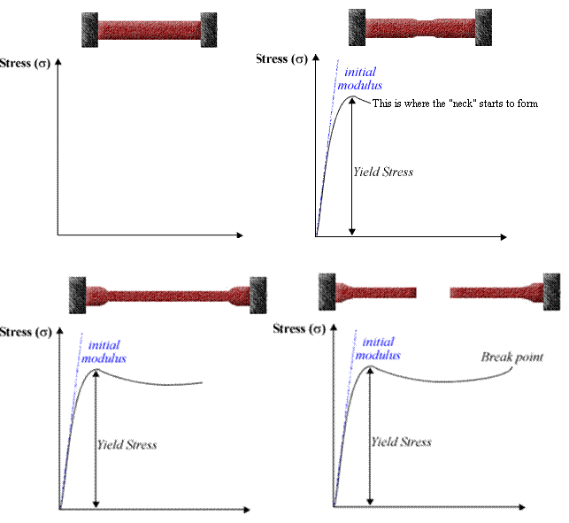
Stress Strain Behavior of Flexible Plastics

Slide 16
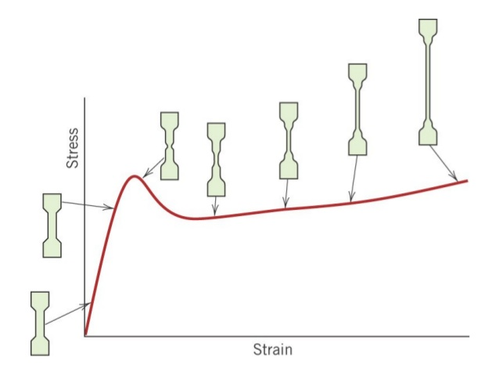
Stress Strain Behavior of Flexible Plastics
As shown by the stress-strain curve above, the modulus of a flexible plastic is initially high. The deformation is elastic only up to the yield point. After a small, initial elongation, the specimen forms a neck. Within the neck region, the chains are oriented in the direction of stretching. This orientation strengthens the material in the neck region so that subsequent deformation causes elongation of the specimen without breaking. After the yield point the material deforms considerably but the deformation is irreversible. Deformation takes place by extension of the neck region without changes in the cross sectional area.

Slide 17
Stress Strain Behavior of Flexible Plastics
This behaviour is typical of semi-crystalline polymers with relatively high melting temperature and low glass transition compared to the working temperature, T>T_{g}. As the area under the stress-strain curve is large, flexible plastics are tough materials.
The mechanism of plastic deformation is a result of the semi-crystalline structure of polymeric materials and the flexibility of the amorphous regions (as T> T_{g}). We can identify a series of different stages during which the chains are extended and crystalline lamellae become oriented along the stretching direction. Two important aspects need to be highlighted:
the importance of tie chains in the orientation process (i.e. chains that provide inter-links between different crystalline regions) and
(b) the flexibility of the amorphous regions which are above the glass transition temperature.

Slide 18
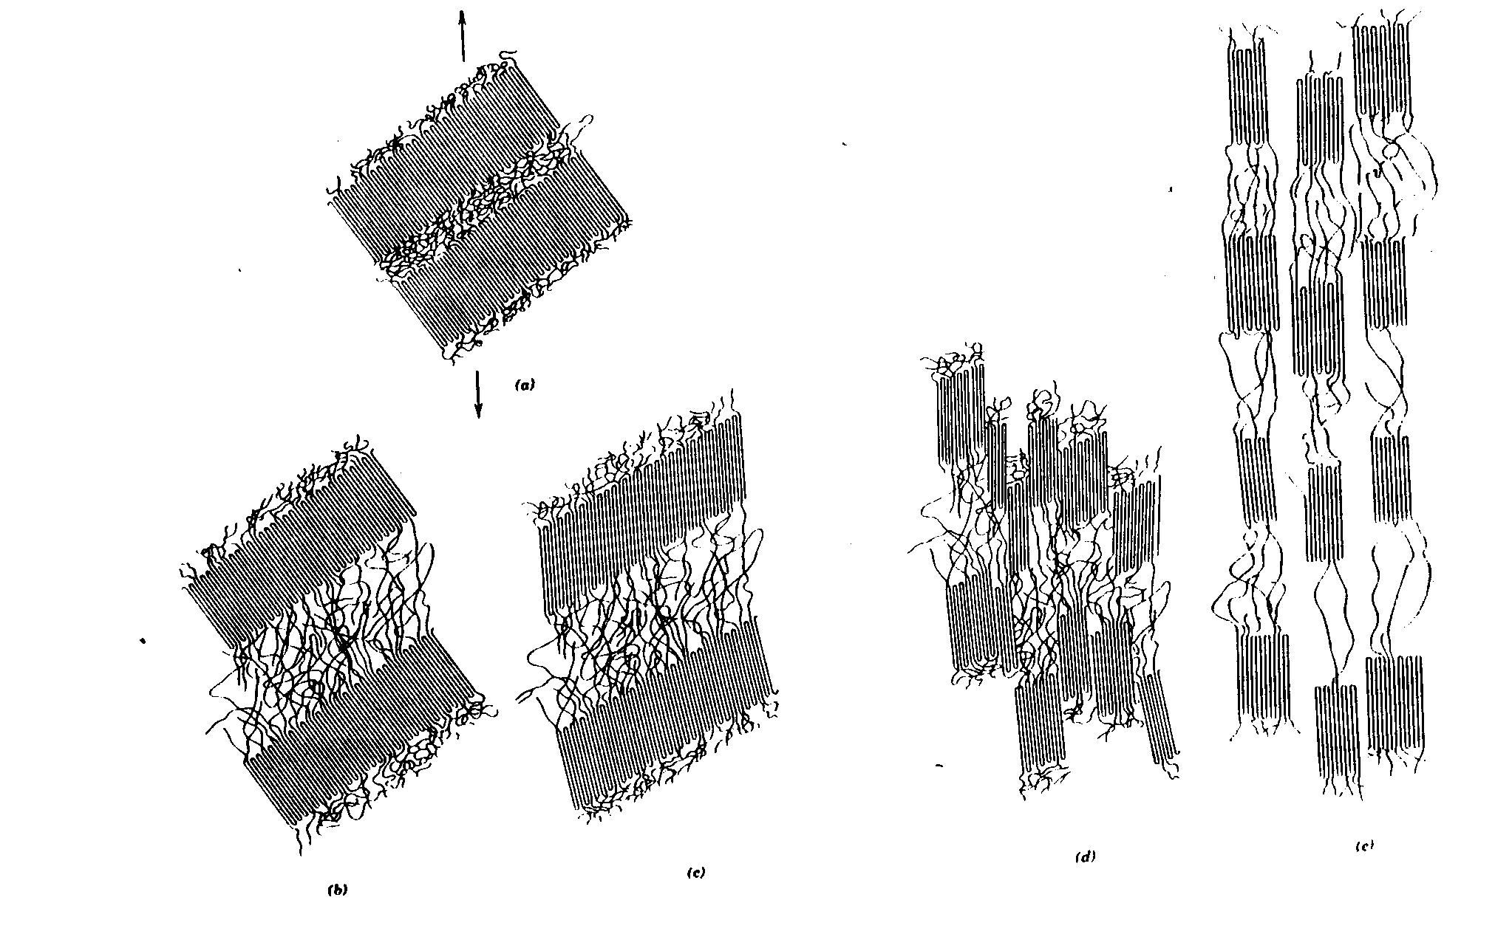
Stress Strain Behavior of Flexible Plastics

Slide 19
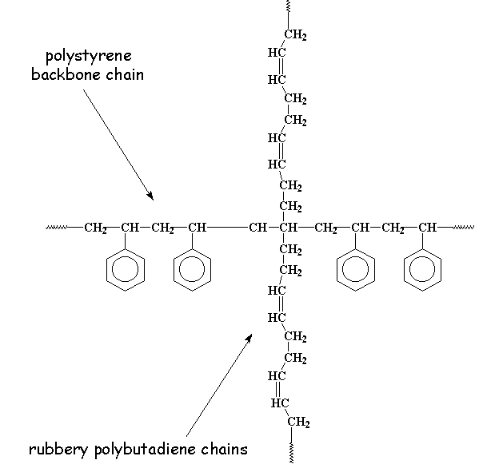
Stress Strain Behavior of Flexible Plastics
Not only semi-crystalline polymers behave as flexible plastics. For example, the stress-strain behaviour of high impact polystyrene (HIPS) is similar to that of flexible plastics. This material incorporates a graft copolymer of polystyrene (PS) and polybutadiene (PB), poly(styrene-g-butadiene) in a polystyrene matrix. Polystyrene and polybutadiene are immiscible and tend to aggregate forming separate regions called domains. HIPS combines the properties of a rigid plastic (PS) with those of an elastomer (PB). HIPS is tougher than PS.

