Slide 1
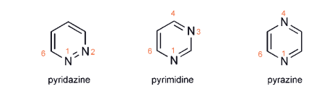
Diazines:
Pyridazine, Pyrimidine and Pyrazine

Slide 2
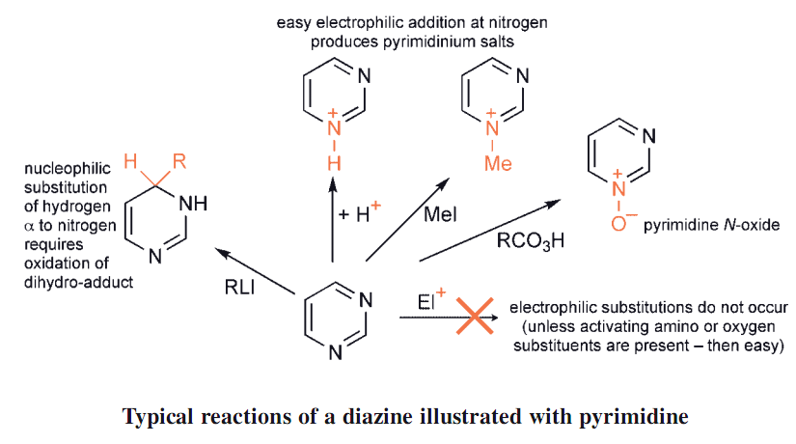
1- Two heteroatoms withdraw electron density from the ring carbons even more than one in pyridine
2- unsubstituted diazines are even more resistant to electrophilic substitution than is pyridine
3- diazines more easily attacked by nucleophiles than pyridine
4- each of the diazines is appreciably less basic than pyridine,
electrophilic additions take place at one nitrogen only, because the presence of the positive charge in the products renders the second nitrogen extremely unreactive towards a second electrophilic addition

Slide 3
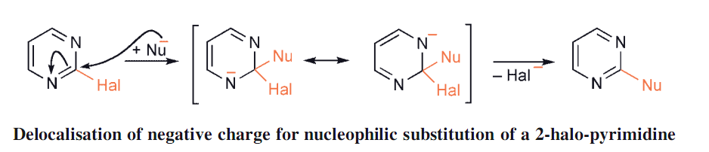
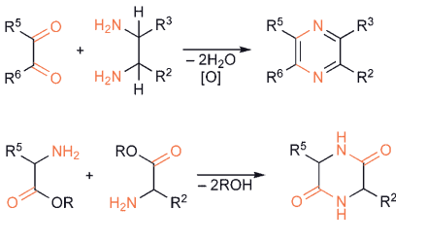
All positions on each of the diazines, with the sole exception of the 5 - position of a pyrimidine, are α and/or γ to an imine ring nitrogen and, in considering nucleophilic addition/substitution, the monohalo - diazines are more reactive than either 2 - or 4 - halo - pyridines
Preparation method
pyrazine produce from 1,2 - diamine and a 1,2 - dicarbonyl compound generate unsymmetrica , or using 2 - aminocarbonyl compounds also generates symmetrically substituted

Slide 4
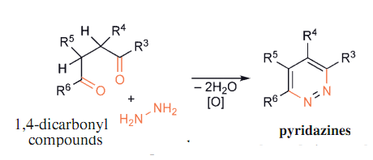
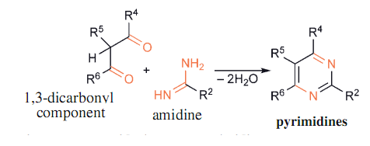
hydrazine and this in combination with 1,4 - dicarbonyl compounds readily produces dihydro - pyridazines
Pyrimidines result from the interaction of a 1,3 - dicarbonyl component and an amidine

Slide 5
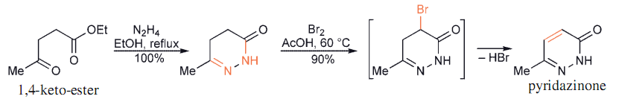
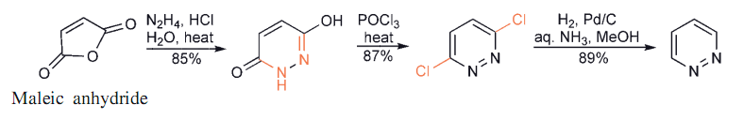
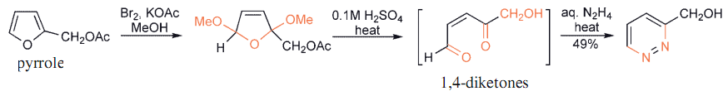
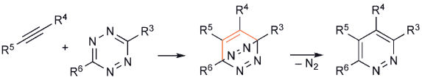

Slide 6
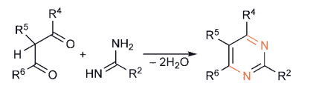
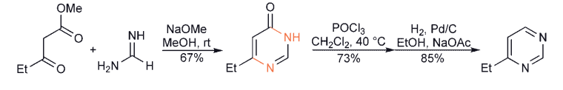
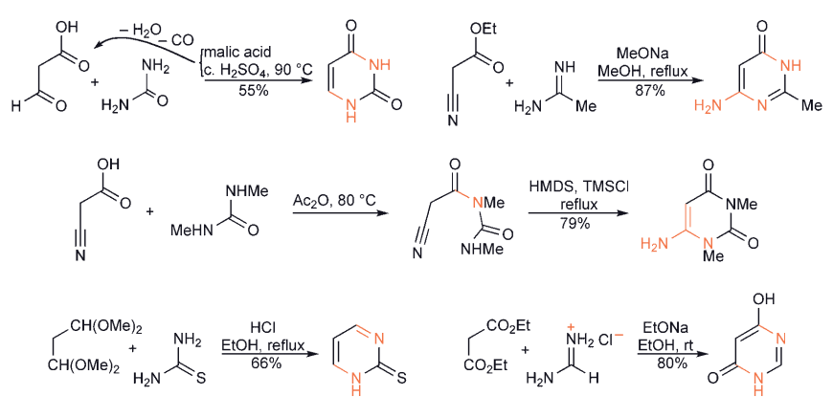

Slide 7
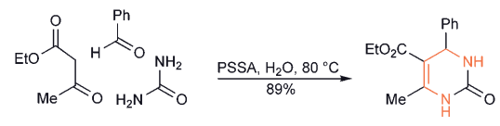

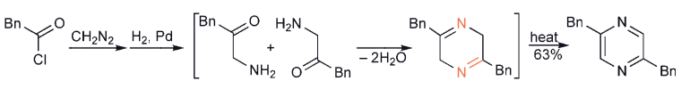


Slide 8

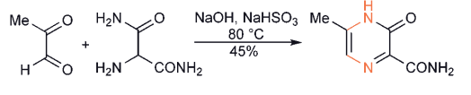
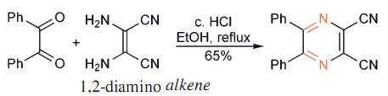
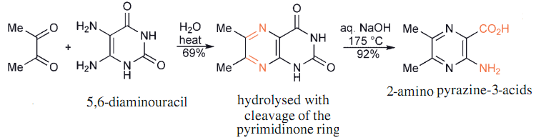

Slide 9
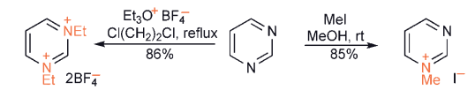
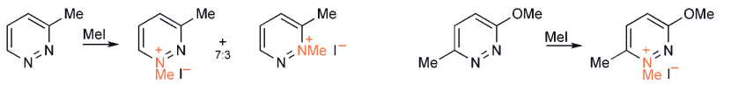
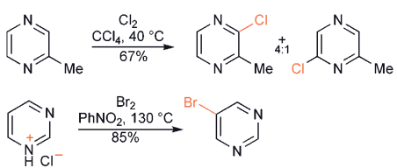
REACTIONS
Alkylation
Substitution at Carbon

Slide 10
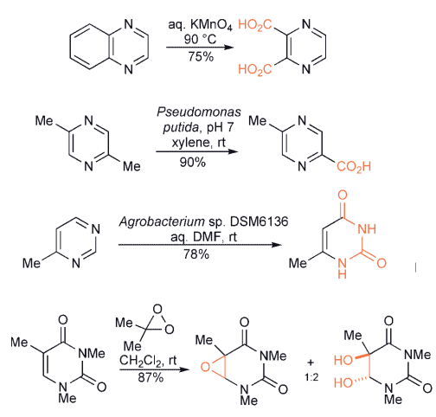
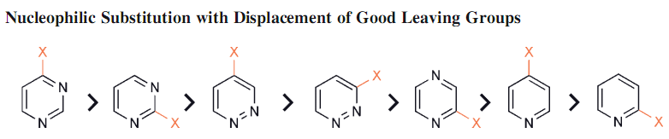

Slide 11
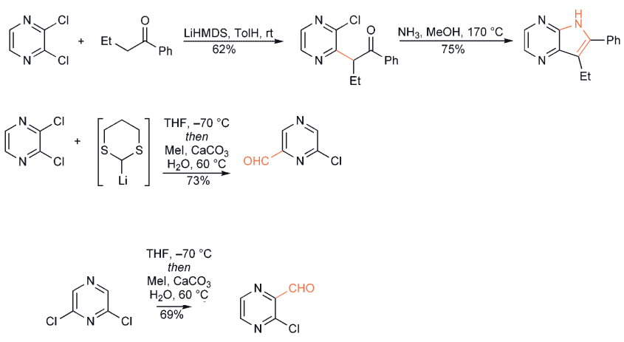


Slide 12
