Slide 1
Lecture # 7
RDF Schema
1st semester 2018-2019
Dr. Abdulhussein M. Abdullah
Computer Science Dept., College of CS & IT, Basrah University

Slide 2
RDF Schema
•RDF Schema provides the framework to describe application-specific classes and properties.
•RDF Schema ‘semantically extends’ RDF to enable us to talk about classes of resources, and the properties that will be used with them.
•Classes in RDF Schema is much like classes in object oriented programming languages. This allows resources to be defined as instances of classes, and subclasses of classes.
•RDF schemas are Web resources (and have URIs) and can be described using RDF

Slide 3
Classes
• A basic step in any kind of description process is
identifying the various kinds of things to be
described. RDF Schema refers to these “kinds of
things” as classes.
• A class in RDF Schema corresponds to the
generic concept of a type or category, somewhat like the notion of a class in object oriented
programming languages such as Java or object oriented data models.

Slide 4
Describing Classes with RDFS
•To describe classes we can use built in RDF Schema resources:
rdfs:Class
rdfs:subClassOf
•These are used in conjunction with the rdf:type property.

Slide 5
rdf:type
• The predefined property rdf:type is used as a predicate in a statement
I rdf:type C
to declare that individual I is an instance of class C.
• In statements of the form
C rdf:type rdfs:Class .
rdf:type is used to declare that class C (viewed as
an individual object) is an instance of the predefined
class rdfs:Class.

Slide 6
Notation
• Class names will be written with an initial
uppercase letter, while property and
instance names are written with an initial
lowercase letter.

Slide 7
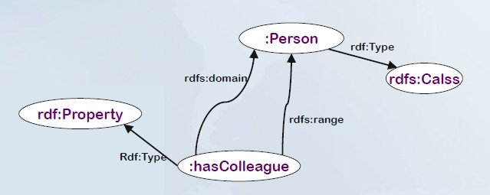
Describing Properties with RDF(S)
•RDF Schema allows us to describe properties. (Properties are instances of the class rdf:Property!)
•We can specify a domain using rdfs:domain.
•We can specify a range using rdfs:range.

Slide 8
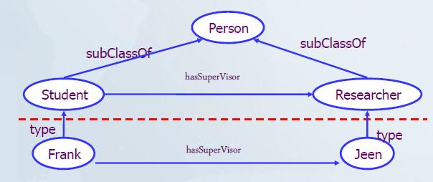
RDF Schema
•Defines small Vocabulary for RDF:
•Class, subClassOf, type
•Property, subPropertyOf
•domain, range
•Vocabulary can be used to define other vocabularies for your application domain.

Slide 9
RDFS Example
Observe that it is an rdf document
<?xml version="1.0"?>
<rdf:RDF
xmlns:rdf= "http://www.w3.org/1999/02/22-rdf-syntax-ns#"
xmlns:rdfs="http://www.w3.org/2000/01/rdf-schema#"
xml:base= "http://www.animals.fake/animals">
<rdfs:Class rdf:ID="animal" />
<rdfs:Class rdf:ID="horse">
<rdfs:subClassOf rdf:resource="#animal"/>
</rdfs:Class>
<rdfs:Class rdf:ID="dog">
<rdfs:subClassOf rdf:resource="#animal"/>
</rdfs:Class>
</rdf:RDF>

Slide 10
RDF Schema (Another Example)
…
<rdf:Description ID=“Teacher">
<rdf:type resource=“rdf:Class"/>
<rdfs:subClassOf rdf:resource=“foaf:Person"/>
</rdf:Description>
<rdf:Description ID=“Course">
<rdf:type resource=“rdf:Class"/>
</rdf:Description>
<rdf:Description ID=“Address">
<rdf:type resource=“rdf:Class"/>
</rdf:Description>
<rdf:Description ID="Truck">
<rdf:type resource="http://www.w3.org/...#Class"/>
<rdfs:subClassOf rdf:resource="#MotorVehicle"/>
</rdf:Description>
<rdf:Description ID="registeredTo">
<rdf:type resource="http://www.w3.org/...#Property"

Slide 11
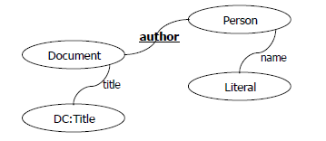
Introductory example
Person writes/authors Document.
Person has name (Literal).
Document has title (DC:title).

Slide 12
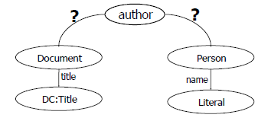
Introductory example 2
Person writes/authors Document.
Person has name (Literal).
Document has title (DC:title).
If we want to focus on the PROPERTY, ...

Slide 13
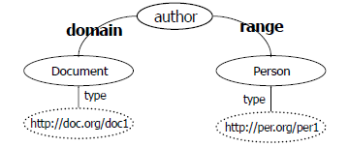
Domain and Range
Person writes/authors Document.
Person has name (Literal).
Document has title (DC:title).
If we want to focus on the PROPERTY, ...

Slide 14
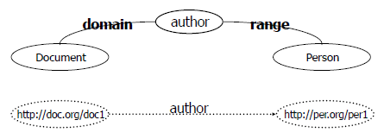
Two-layer structure
Person writes/authors Document.
Person has name (Literal).
Document has title (DC:title).
If we want to focus on the PROPERTY, ...

Slide 15
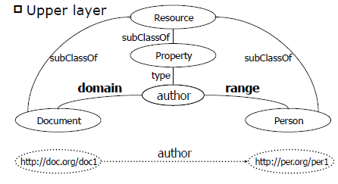
Two-layer structure

Slide 16
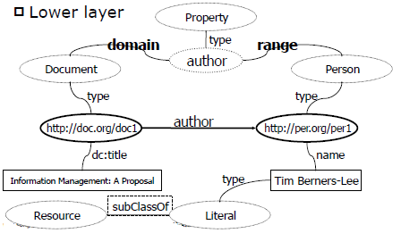
Two-layer structure

Slide 17
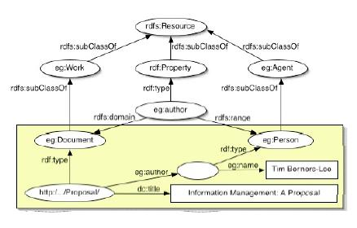
Introductory example 3
A simple example is presented here in diagrammatic form, illustrating the use of the RDF Schema vocabulary for describing classes and properties, and the connection to application-level data.

Slide 18
RDF Schema Model (General)
Property-centric: Each property specifies what classes of subjects and objects it relates. New properties can be added to a class without modifying the class
" resource, class, subClassOf, type
" property, subPropertyOf
" domain, range, constraintResource, constraintProperty
Definitions can include constraints which express validation conditions
" domain constraints link properties with classes
" range constraints limit property values
! BUT… expressiveness inadequacy and poorly defined semantics

Slide 19
Property-centric: Domain and Range
The RDF Schema class and property system is similar to the type systems of object-oriented
programming languages such as Java. However,
RDF differs from many such systems in that instead of defining a class in terms of the properties its instances may have, an RDF schema will define properties in terms of the classes of resource to which they apply. This is the role of the rdfs:domain and rdf:range mechanisms.

Slide 20
RDF Core Classes and Properties 1
rdfs:Resource
All things described by RDF are called resources, and are members of the class rdfs:resource.
rdfs:Literal
The class rdfs:literal represents the self-denoting nodes called the 'literals' in the RDF graph structure. Property values such as textual strings are examples of RDF literals.
rdfs:Class
This corresponds to the generic concept of a type or category of resource.
* RDF class membership is used to represent types or categories of resources. Two classes may happen to have the same members, while remaining distinct resources.

Slide 21
Example
<rdfs:Class rdf:ID="Animal">
<rdfs:label>Animal</rdfs:label>
<rdfs:comment>
This class of animals is illustrative
of a number of ontological idioms.
</rdfs:comment>
</rdfs:Class>

Slide 22
rdf:Property
rdf:Property represents those resources that are RDF properties.
rdf:type
The rdf:type, property indicates that a resource is a member of a class.
* When a resource has an rdf:type , property whose value is
some specific class, we say that the resource is an
instance of the specified class.
The value of an rdf:type , property will always be a resource
that is an instance of rdfs:class. The resource known as
rdfs:class is itself a resource of rdf:type , rdfs:class.

Slide 23
Example
<rdf:Property rdf:ID="hasParent">
<rdfs:domain rdf:resource="#Animal"/>
<rdfs:range rdf:resource="#Animal"/>
</rdf:Property>
<rdf:DatatypeProperty rdf:ID="shoesize">
<rdfs:comment>shoesize is a DatatypeProperty whose
range is xsd:decimal. shoesize is also a UniqueProperty
(can only have one shoesize)
</rdfs:comment>
<rdf:type
rdf:resource="http://www.w3.org/2001/10/daml+oil#UniqueProperty"/>
<rdfs:range
rdf:resource="http://www.w3.org/2000/10/XMLSchema#decimal"/>
</rdf:DatatypeProperty>

Slide 24
rdfs:subClassOf
The rdfs:subClassOf property represents a specialization relationship between classes of resources. The rdfs:subClassOf
property is transitive.
rdfs:subPropertyOf
The property rdfs:subPropertyOf is an instance of rdf:property
that is used to specify that one property is a specialization of another.
Sub-property hierarchies can be used to express hierarchies
of range and domain constraints.
* The term 'super-property' is sometimes used to indicate
the relationship between some property and another more
general property that it is a rdfs:subPropertyOf.

Slide 25
Example
<rdfs:Class rdf:ID="Male">
<rdfs:subClassOf rdf:resource="#Animal"/>
</rdfs:Class>
<rdf:Property rdf:ID="hasFather">
<rdfs:subPropertyOf rdf:resource="#hasParent"/>
<rdfs:range rdf:resource="#Male"/>
</rdf:Property>

Slide 26
rdfs:range and rdfs:domain
An instance of rdf:property used to indicate class(es) that
the values of a property will be members of.
The value of rdfs:range and rdfs:domain property is always a
Rdfs:class. The rdfs:range and rdfs:domain property can itself be used to express this, e.g: the rdfs:range of rdfs:range, is the
class Rdfs:class. This indicates that any resource that is the
value of a range property will be a class.
The rdfs:range and rdfs:domain property is only applied to
properties. The rdfs:range and rdfs:domain is the class
Rdf:property. This indicates that the range property applies to
resources that are themselves properties.

Slide 27
Note: range, domain, and sub-property hierarchies
Sub-property hierarchies can be used to express hierarchies of range and domain constraints. All rdfs:domain and rdfs:range properties that apply to an RDF property also apply to each of its sub-properties.

Slide 28
rdfs:label
The rdfs:label property is used to provide a human-readable
version of a resource's name.
rdfs:comment
The rdfs:comment property is used to provide a human readable
description of a resource. A textual comment helps clarify the meaning of RDF classes and properties. Such inline documentation complements the use of both formal techniques (Ontology and rule
languages) and informal (prose documentation, examples, test cases). A variety of documentation forms can be combined to indicate the intended meaning of the classes and properties described in an RDF Schema. Multilingual text is supported with xml:lang.

Slide 29
rdfs:Container
The rdfs:Container class is a super-class of the RDF Container
classes, i.e., rdf:Bag , rdf:Seq, rdf:Alt
rdf:Bag
The rdf:Bag class represents RDF's 'Bag' container construct, and is a subclass of rdfs:Container.
rdf:Seq
The rdf:Seq class represents RDF's 'Sequence' container
construct, and is a subclass of rdfs:Container.
rdf:Alt
The rdf:Alt class represents RDF's 'Alt' container construct,
and is a subclass of rdfs:Container.

