Slide 1
Regular Expression
From Arden’s Theorem
2nd Semester 2017-2018
Dr. Abdulhussein M. Abdullah
Lec #6

Slide 2
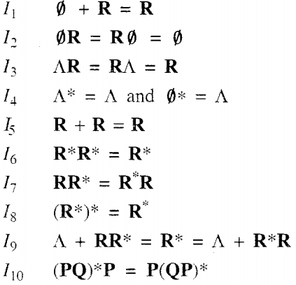
Identities of Regular Expression:-

Slide 3
Arden's Theorem
Let’s assume that P and Q be two regular expressions.
Incase if P does not include a ϵ, then
R = Q + RP has a unique solution that is
R = QP*

Slide 4
Proof
R = Q + (Q + RP)P
[After putting the value R = Q + RP]
R = Q + QP + RPP
If you include the value of R recursively repetitively then you will get the following equation −

Slide 5
Assumptions for Applying Arden’s Theorem
The transition diagram must not have ϵ transitions
It must have only one initial state

Slide 6
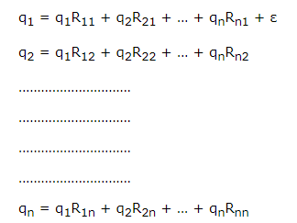
Method
Step 1 – Now create equations in the below mentioned form for all the states of the DFA having n states with initial state q1.
Rij represents the set of labels of edges from qi to qj, if no such edge exists, then Rij = ∅
Step 2 − Solve these equations to get the equation for the final state in terms of Rij

Slide 7
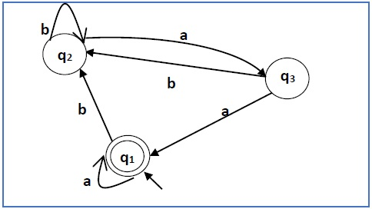
Problem
Construct a regular expression related to the automata given below.

Slide 8
Solution
Here the initial state is q2 and the final state is q2.
The equations for the three states q1, q2, and q3 are as follows −

Slide 9
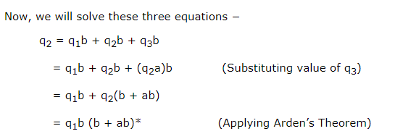

Slide 10
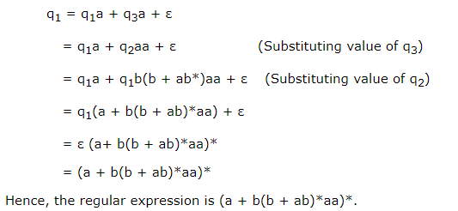

Slide 11
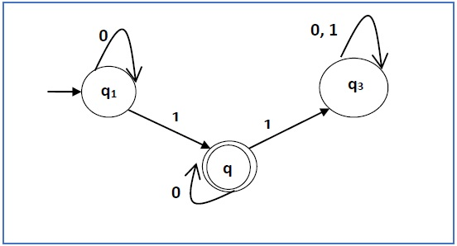
Problem 2
construct a regular expression related to the automata given below −

Slide 12
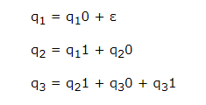
Solution
Here the initial state is q1 and the final state is q2
Let’s write the below equations −

Slide 13
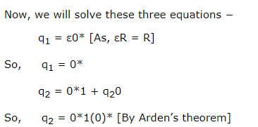
Hence, the regular expression is 0*10*

