Slide 1
Advanced Calculus Second Class Polar Coordinates By Dr. Jawad Mahmoud Jassim Dept. of Math. College of Education for Pure Sciences University of Basrah Iraq

Slide 2
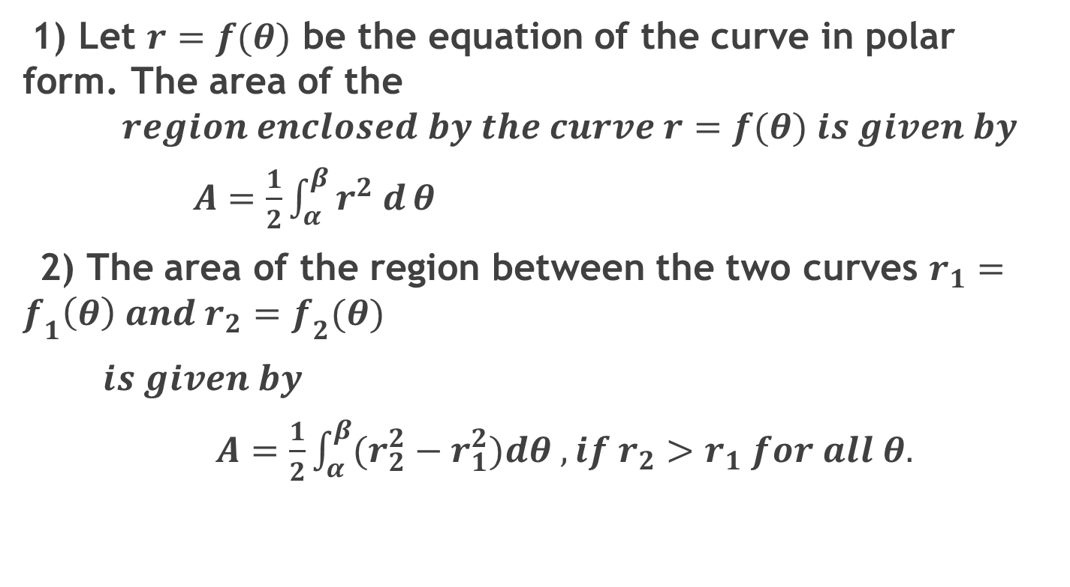
4: Area in the Plane
1) Let $r=f(θ)$ be the equation of the curve in polar form. The area of the
$$region enclosed by the curve r=f(θ) is given by$$
$A=\frac{1}{2}\int_{α}^{β}{r^{2} d}θ$
2) The area of the region between the two curves $r_{1}=f_{1}\left(θ\right) and r_{2}=f_{2}(θ)$
$is given by$
$A=\frac{1}{2}\int_{α}^{β}{(r_{2}^{2}}−r_{1}^{2})dθ , if r_{2}>r_{1} for all θ.$

Slide 3
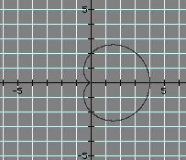
Example (8):
Find the total area enclosed by the curve $r=a(1+\cos{θ) , a>0 .}$
Solution:
$A=\frac{1}{2}\int_{α}^{β}{r^{2} d}θ=\frac{1}{2}\int_{0}^{2π}{a^{2}{(1+\cos{θ)}}^{2}dθ=}\int_{0}^{π}{a^{2}{(1+\cos{θ)}}^{2}dθ=}$
$a^{2}\int_{0}^{π}{(1+2\cos{θ+\cos^{2}θ)dθ}}$
$= {a^{2} [ θ+2\sin{θ+\frac{1}{2} θ \sin{2θ]}}}_{0}^{π}= \frac{3}{2} a^{2}π.$ Units square.

Slide 4
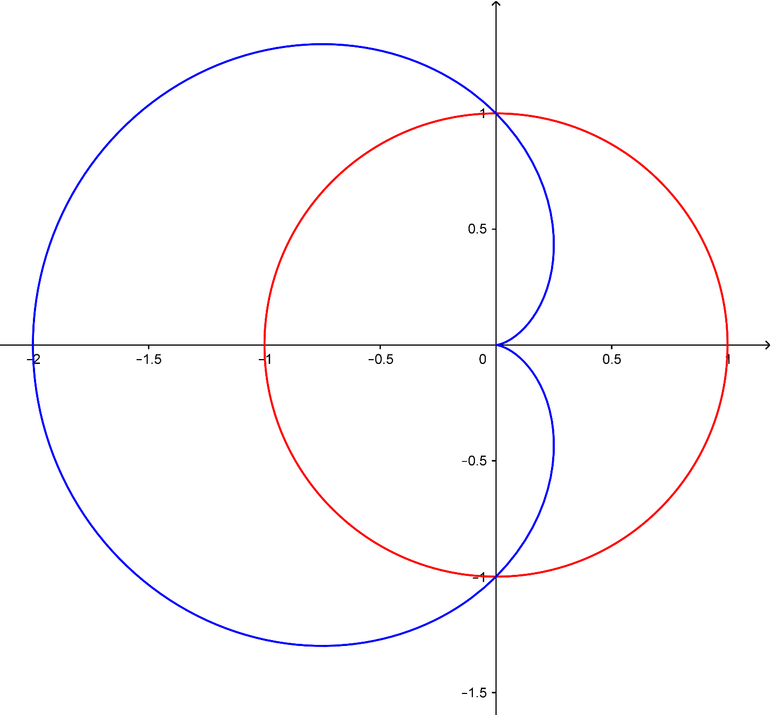
Example (9):
Find the area of the region that lies inside the circle $r=a$ and outside the curve $r=a(1−\cos{θ) , a>0 .}$
Solution:

Slide 5
First, we find the intersection points between the two curves.
$a(1−\cos{θ)=a →1−\cos{θ=1 → \cos{θ=0 → θ=∓\frac{π}{2} .}}}$
⸫ $A=\frac{1}{2}\int_{α}^{β}{(r_{2}^{2}}−r_{1}^{2})dθ=\frac{1}{2}\int_{−\frac{π}{2}}^{\frac{π}{2}}{ \left[a^{2}−a^{2}{(1−\cos{θ)}}^{2}\right]dθ}$
$=\int_{0}^{\frac{π}{2}}{ \left[2a^{2}\cos{θ}−a^{2}\cos^{2}θ\right]dθ={[ 2a^{2} \sin{θ]}}_{0}^{\frac{π}{2} }}−\frac{1}{2}a^{2}{[θ+\frac{1}{2} \sin{2θ]}}_{0}^{\frac{π}{2}}$
$=\left(\frac{8−π}{4}\right)a^{2} units square.$

Slide 6
5: Length of a Polar Curves:
If $r=f(θ)$ has continuous first derivative for $α≤θ≤β ,$ then the length of the curve is given by
$L=\int_{α}^{β}{ \sqrt{r^{2}+{(\frac{dr}{dθ})}^{2} }}dθ .$
Example (10):
Find the length of the cardioid $r=1−\cos{θ .}$
Solution:
$\frac{dr}{dθ}=\sin{θ → r^{2}}+{(\frac{dr}{dθ})}^{2}=1−2\cos{θ+\cos^{2}θ+\sin^{2}θ=2−2\cos{θ .}}$
⸫$L=\int_{0}^{2π}{ \sqrt{2−2\cos{θ }}}dθ=\int_{0}^{2π}{ \sqrt{4\sin^{2} \frac{θ}{2}}} dθ=2\int_{0}^{2π}{\sin{\frac{θ}{2}}} dθ .$
$\left(\sin{\frac{θ}{2}}≥0 for 0≤θ≤2π \right)$
⸫$L={[ −4 \cos{\frac{θ}{2}}]}_{0}^{2π}=8 units.$

Slide 7
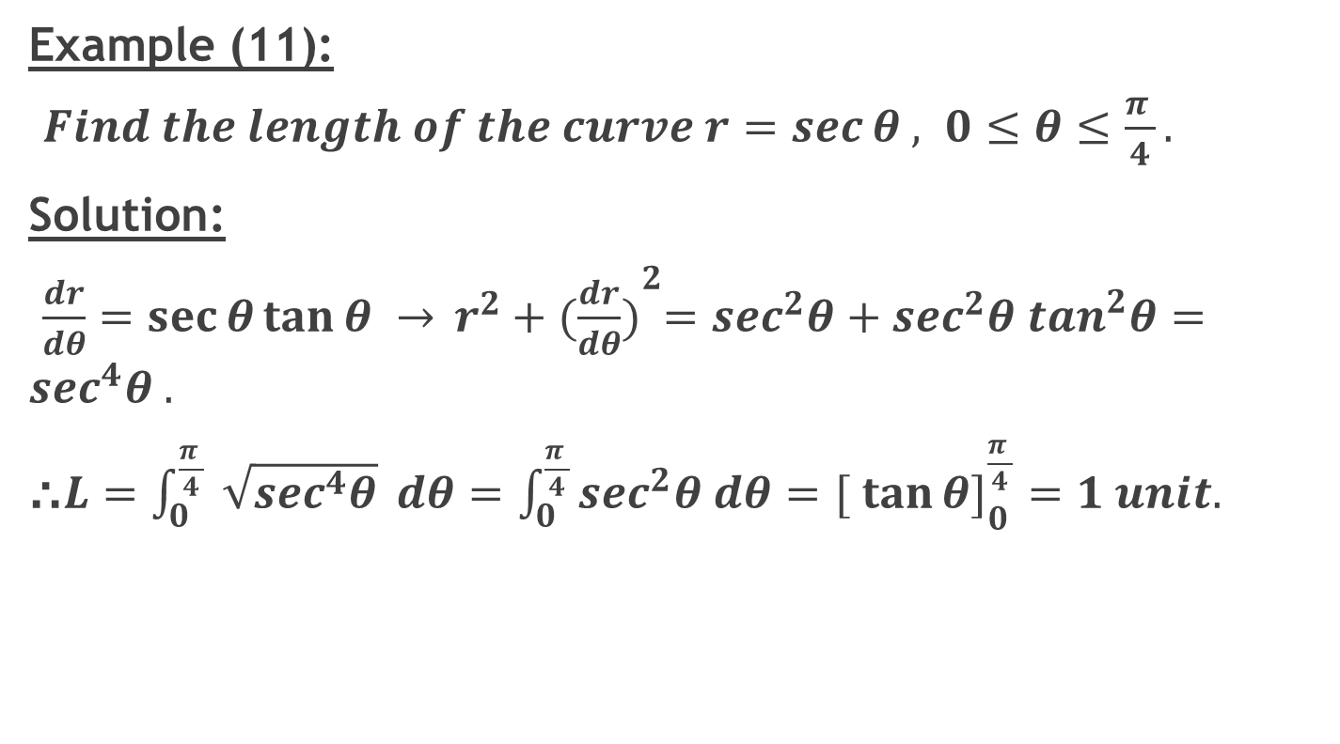
Example (11):
$Find the length of the curve r=\sec{θ , 0≤θ≤\frac{π }{4}}.$
Solution:
$\frac{dr}{dθ}=\sec{θ}\tan{θ → }r^{2}+{(\frac{dr}{dθ})}^{2}=\sec^{2}θ+\sec^{2}θ \tan^{2}θ=\sec^{4}θ .$
⸫$L=\int_{0}^{\frac{π }{4}}{ \sqrt{\sec^{4}θ}} dθ=\int_{0}^{\frac{π }{4}}{\sec^{2}θ dθ={[ \tan{θ}]}_{0}^{\frac{π }{4}}}=1 unit.$

Slide 8
6: Average Value:
If $f(θ)$ is continuous function, the average value of the polar coordinates over the curve $r=f\left(θ\right), α≤θ≤β ,$ is given by
$r_{av}=\frac{1}{β−α}\int_{α}^{β}{ f\left(θ\right)dθ}$.
Example (12):
Find the average value of $r$ with respect to $θ$ over the curve
$r=a\cos{θ ,a>0,}$ $−\frac{π}{2}≤θ≤\frac{π}{2} .$
Solution:
$r_{av}=\frac{1}{β−α}\int_{α}^{β}{ f\left(θ\right)dθ=\frac{1}{π}} \int_{−\frac{π}{2}}^{\frac{π}{2}}{ a\cos{θ dθ={[ \frac{a}{π} \sin{θ}]}_{−\frac{π}{2}}^{\frac{π}{2}}}}=\frac{2a}{π} .$

