Slide 1
Advanced Calculus Second Class Polar Coordinates By Dr. Jawad Mahmoud Jassim Dept. of Math. College of Education for Pure Sciences University of Basrah Iraq

Slide 2
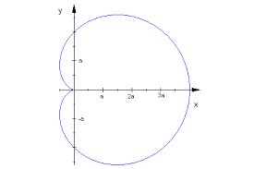
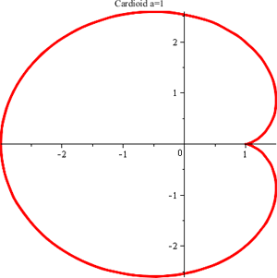

Some Common Curves
1: The Cardioids
$r=a(1+\cos{θ})$
$$r=a(1−\cos{θ})$$

Slide 3
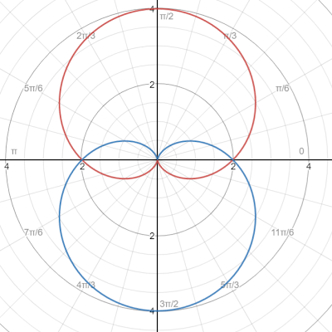

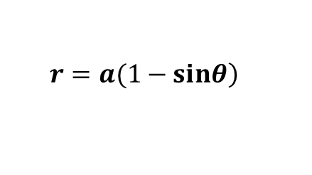
$$r=a(1+\sin{θ)}$$
$$r=a(1−\sin\left.θ\right)$$

Slide 4
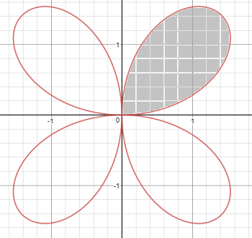
2: Four-Leaved Rose
$r=a\sin{2θ}$

Slide 5
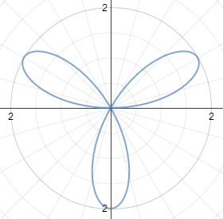
3: Three- Leaved Rose
$r=a\sin{3θ}$

Slide 6
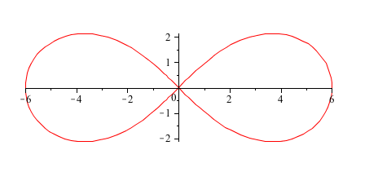
Note:
If $r=a\sin{mθ}$ is a given curve.
1: If m is an even number, then the number of leaves 2m.
2: if m is an odd number, then the number of leaves m.
4: The Lemniscates
$$r^{2}=a^{2}\cos{2θ}$$

Slide 7
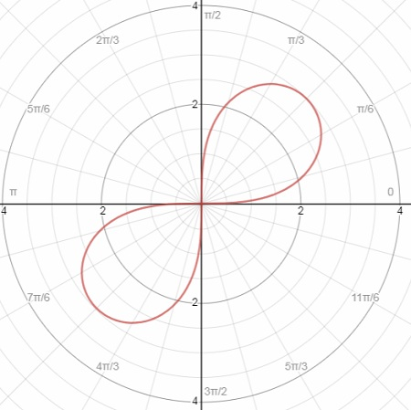
$$r^{2}=a^{2}\sin{2θ}$$

Slide 8
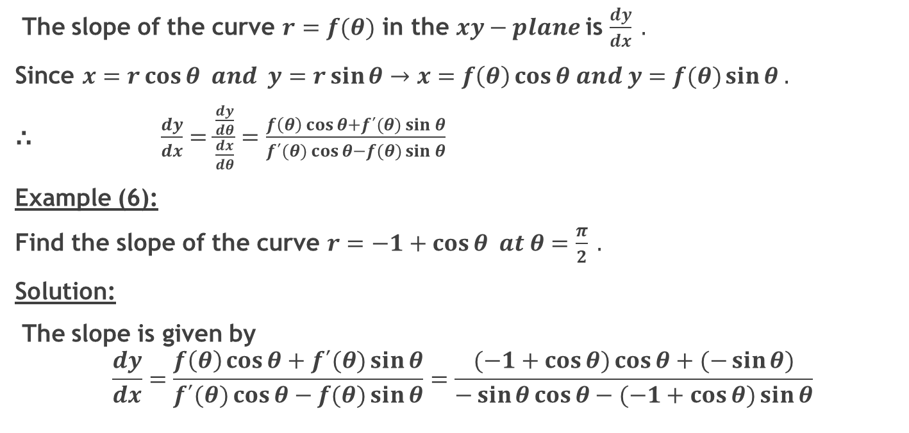
Slope of the Curve $r=f(θ)$ $in the$ $Cartesian$ $xy−Plane$:
The slope of the curve $r=f(θ)$ in the $xy−plane$is $\frac{dy}{dx} .$
Since $x=r\cos{θ and y=r\sin{θ→x=f\left(θ\right)\cos{θ and y=f(θ)\sin{θ .}}}}$
⸫$\frac{dy}{dx}=\frac{\frac{dy}{dθ}}{\frac{dx}{dθ}}=\frac{f\left(θ\right)\cos{θ+f´(θ)\sin{θ}}}{f´(θ)\cos{θ−f(θ)\sin{θ}}}$
Example (6):
Find the slope of the curve $r=−1+\cos{θ at θ=\frac{π}{2} .}$
Solution:
The slope is given by
$$\frac{dy}{dx}=\frac{f\left(θ\right)\cos{θ+f´(θ)\sin{θ}}}{f´(θ)\cos{θ−f(θ)\sin{θ}}}=\frac{(−1+\cos{θ)\cos{θ+(−\sin{θ)}}}}{−\sin{θ\cos{θ−(−1+\cos{θ})}}\sin{θ}}$$

Slide 9
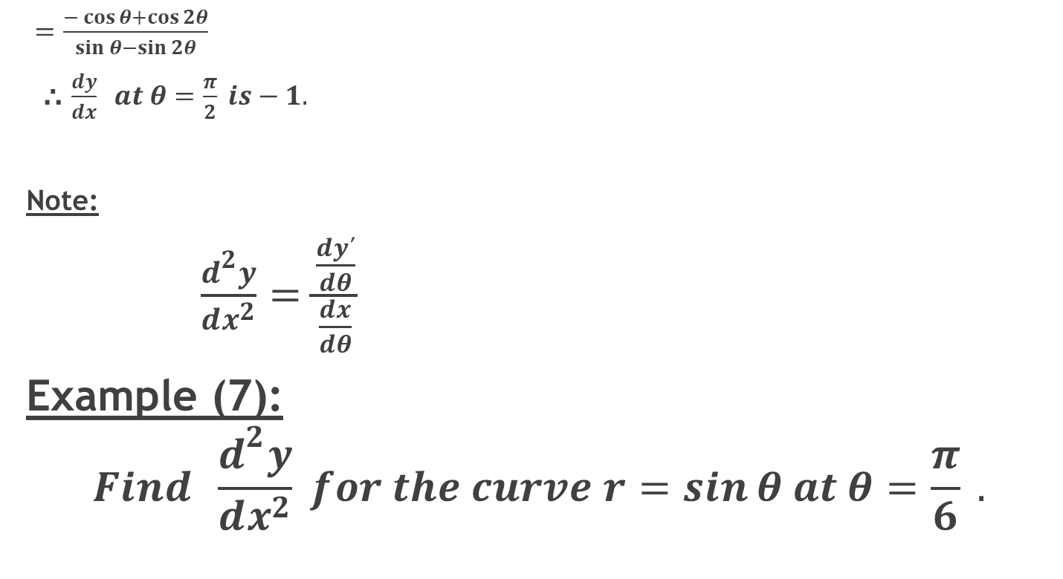
$=\frac{−\cos{θ+\cos{2θ}}}{\sin{θ−\sin{2θ}}}$
⸫ $\frac{dy}{dx} at θ=\frac{π}{2} is−1.$
Note:
$\frac{d^{2}y}{dx^{2}}=\frac{\frac{dy´}{dθ}}{\frac{dx}{dθ}}$
Example (7):
$$Find \frac{d^{2}y}{dx^{2}} for the curve r=\sin{θ at θ=\frac{π}{6}} .$$

Slide 10
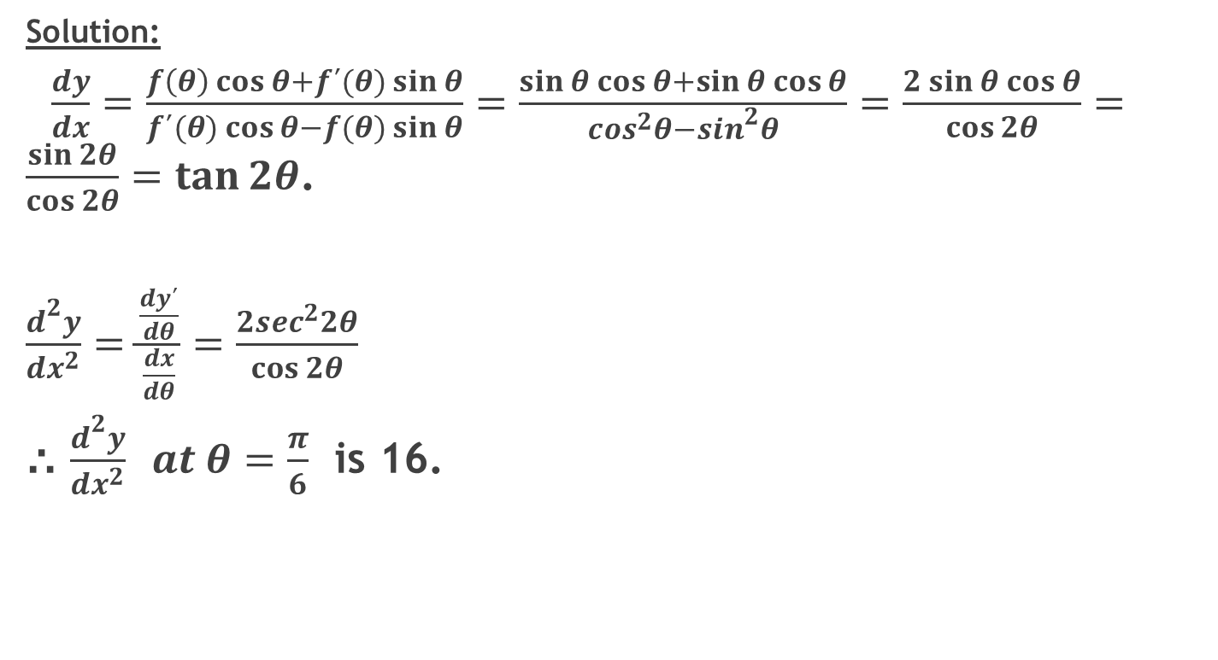
Solution:
$\frac{dy}{dx}=\frac{f\left(θ\right)\cos{θ+f´(θ)\sin{θ}}}{f´(θ)\cos{θ−f(θ)\sin{θ}}}=\frac{\sin{θ}\cos{θ+\sin{θ}\cos{θ}}}{\cos^{2}θ−\sin^{2}θ}=\frac{2\sin{θ}\cos{θ}}{\cos{2θ}}=\frac{\sin{2θ}}{\cos{2θ}}=\tan{2θ}$.
$\frac{d^{2}y}{dx^{2}}=\frac{\frac{dy´}{dθ}}{\frac{dx}{dθ}}=\frac{2\sec^{2}2θ}{\cos{2θ}}$
⸫ $\frac{d^{2}y}{dx^{2}} at θ=\frac{π}{6}$ is 16.

