Slide 1
Advanced Calculus Second Class Polar Coordinates By Dr. Jawad Mahmoud Jassim Dept. of Math. College of Education for Pure Sciences University of Basrah Iraq

Slide 2
3: Graphing Polar Coordinates Curves:
$Let the equation in polar form given by$ $r=f(θ)$. To graph the curves in polar form, we must find all ordered pairs $(r,θ)$ which satisfy the equation $r=f(θ)$, $then plot the points (r,θ).$
We do the following steps:
First: Determine the Domain
We find the values of $θ$ which satisfy the given equation.
For example the domain of the function $r=\sqrt{\cos{θ}}$ is:
$\cos{θ ≥0 → −\frac{π}{2}≤θ≤\frac{π}{2} .}$ That is θ lies in the 1st and 4th quadrants.

Slide 3
Second: Determine the Symmetry
There are three types of symmetries:
1: Symmetry about the Pole:
A curve is symmetric about the pole if replacing $θ$ by $θ+π$ or replacing $r$ $by −r$ in its equation produces an equivalent equation.
(r, θ)
(- r, θ)
or
(r, θ + π)

Slide 4
2: Symmetry about the Polar Axis
A curve is symmetric about the polar axis (initial axis) if replacing $θ$ by $–θ$
$in$ its equation produces an equivalent equation.
(r, θ)
( r, - θ)

Slide 5
3: Symmetry about the Vertical Line $θ=\frac{π}{2}$
$A curve is symmetric about the line$ $θ=\frac{π}{2} if replacing$ $θ$ $by$ $π−θ$ $in its$ $equation produces an equivalent equation.$
(r, π- θ) (r, θ)

Slide 6
Third: Determine the Intersection Points
1: The Intersection Points with the Polar Axis
To find the intersection points with the polar axis put $θ=0$ & $θ=π$ in the
$equation$ $of the curve$, then find $r .$
2: The Intersection Points with the Vertical Line
To find the intersection points with the $line$ $θ=\frac{π}{2}$ , put $θ=\frac{π}{2} \& θ=\frac{3π}{2}$ in
$the equation of the curve$, $then find$ $r$ .

Slide 7
Forth: Determine Increasing and Decreasing Intervals
The curve of the function $r=f(θ)$ is increasing if $\frac{dr}{dθ} >0$and it is decreasing
$if$ $\frac{dr}{dθ} <0 .$
Fifth: Determine Further Points
We can select further points in the domain of the function.
Sixth: Graphing the Curve
$Plot the obtained points in the xy− plane$ $and draw$ $the$ $given$
$curve$.

Slide 8
Example (4):
Graph the curve $r=a(1+\cos{θ) , a>0}$ (constant).
Solution:
1: The Domain
$0≤θ≤2π .$
Since $−1≤\cos{θ≤1 → 1−1≤1+\cos{θ≤1+1 →0≤}}1+\cos{θ≤2}$
$→0≤ a(1+\cos{θ) ≤2a →0≤r≤2a .}$
2: The Symmetry:
A: No, symmetry about the pole.
B: No, symmetry about the line $θ=\frac{π}{2}$ $because$ $\cos{(π−θ)≠\cos{θ}}$.
C: The curve is symmetric about the polar axis because $\cos\left(−θ\right)=\cos{θ .}$

Slide 9
3: The Intersection Points:
A: With the Polar Axis:
Let $θ=0 →r=2a →The intersection point is \left(2a,0\right).$
Let $θ=π →r=0 →The intersection point is \left(0,π\right).$
B: With the Line $θ=\frac{π}{2} :$
Let $θ=\frac{π}{2} →r=a →The intersection point is \left(a, \frac{π}{2}\right).$
4: Increasing and Decreasing:
We know that $\frac{dr}{dθ}= −a\sin{θ}$.
A: $Since \sin{θ >0} in the 1st and 2nd quadrants$ →
$$\frac{dr}{dθ}<0 in the 1st and 2nd quadrants →$$
$The curve is decreasing in the 1st and 2nd quadrants.$
B: $Since \sin{θ <0} in the 3rd and 4th quadrants →$
$\frac{dr}{dθ}>0 in the 3rd and 4th quadrants →$
$The curve is increasing in the 3rd and 4th quadrants.$

Slide 10
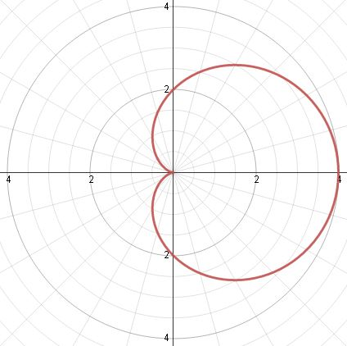
5: Further Points:
6: Draw the Curve:
$$θ$$ | $$0$$ | $$\frac{π}{6}$$ | $$\frac{π}{4}$$ | $$\frac{π}{3}$$ | $$\frac{π}{2}$$ | $$\frac{2π}{3}$$ | $$2π$$
$$r$$ | $$2a$$ | $$1.8a$$ | $$1.6a$$ | $$1.5a$$ | $$a$$ | $$0.5a$$ | $$2$$

Slide 11
Example (5): $Graph the curve r=2\cos{θ} .$
Solution:
1: The Domain
$0≤θ≤2π .$
Since $−1≤\cos{θ≤1 → −2≤2\cos{θ≤2 →−2≤r≤2→0≤r≤2.}}$
2: The Symmetry
A: No, symmetry about the pole.
B: There is a symmetry about the polar axis because $\cos\left(−θ\right)=\cos{θ .}$
C: No, symmetry about the line $=\frac{π}{2}$ $because$ $\cos{(π−θ)≠\cos{θ}}.$
3: Intersection Points
A: With the Polar Axis:
Let $θ=0 →r=2 →The intersection point is \left(2,0\right).$
Let $θ=π →r=−2 →The intersection point is \left(−2,π\right).$

Slide 12
B: With the Vertical Line:
Let $θ=\frac{π}{2} →r=0 →The intersection point is \left(0, \frac{π}{2}\right).$
Let $θ=\frac{3π}{2} →r=0 →The intersection point is \left(0, \frac{3π}{2} \right).$
4: Increasing and Decreasing
We know that $\frac{dr}{dθ}= −2\sin{θ}$.
A: $Since \sin{θ >0} in the 1st and 2nd quadrants$ →
$$\frac{dr}{dθ}<0 in the 1st and 2nd quadrants →$$
$$The curve is decreasing in the 1st and 2nd quadrants.$$
$$B: Since \sin{θ <0} in the 3rd and 4th quadrants →$$
$$\frac{dr}{dθ}>0 in the 3rd and 4th quadrants$$
$$The curve is increasing in the 3rd and 4th quadrants.$$

Slide 13
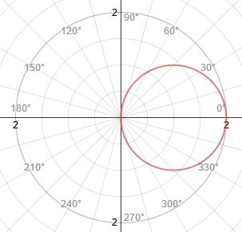
5: Further Points
6: Draw the Curve
$$θ$$ | $$0$$ | $$\frac{π}{6}$$ | $$\frac{π}{3}$$ | $$\frac{π}{2}$$ | $$\frac{2π}{3}$$ | $$\frac{5π}{6}$$ | $$\frac{4π}{3}$$
$$r$$ | $$2$$ | $$1.7$$ | $$1$$ | $$0$$ | $$−1$$ | $$−1.7$$ | $$−1$$

Slide 14
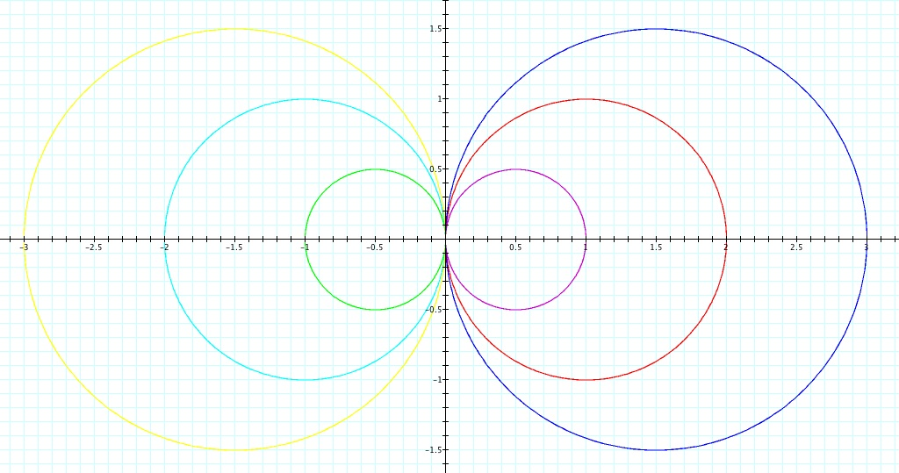
Notes:
1: The equation $r=a\cos{θ (a is a constant)}$ represents a circle whose
$center lies on the polar axis$. If $a>0$ the circle lies at the right of the $line$ $θ=\frac{π}{2} .$ If $a<0 the circle lies at the left of the$ $line$ $θ=\frac{π}{2}$.
$r=a\cos{θ \left(a<0\right) r=a\cos{θ (}}a>0)$

Slide 15
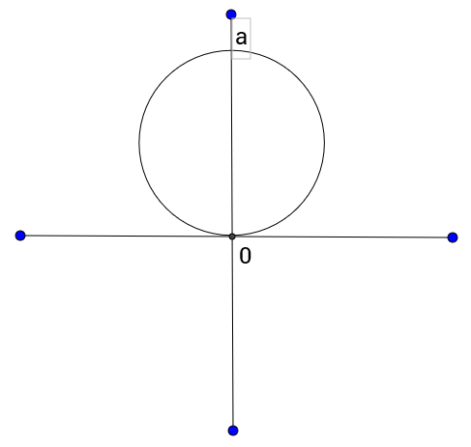
2: The equation $r=a\sin{θ (a is a constant)}$ represents a circle whose
$center lies on the line$ $θ=\frac{π}{2} .$ If $a>0$ the circle lies above the polar axis.
If $a<0$ the circle lies below the polar axis.
$r=a\sin{θ (a>0)}$

Slide 17
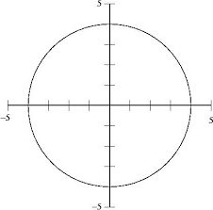
3: The equation $r=a (a>0)$ represents a circle whose center at the origin
$and radius$ $a$.

