Slide 1
Create a Figure for the Simple Programmatic UI Add the following lines before the end statement in your file to create a figure and position it on the screen. % Create and then hide the UI as it is being constructed. f = figure('Visible','off','Position',[360,500,450,285]); The call to the figure function uses two property/value pairs: • The Visible property makes the window invisible so that the user cannot see the components being added or initialized. The window becomes visible when the UI has all its components and is initialized.
• The Position property is a four-element vector that specifies the location of the UI on the screen and its size: [distance from left, distance from bottom, width, height]. Default units are pixels.

Slide 2
Add Components to the Simple Programmatic UI Create the push buttons, static text, pop-up menu, and axes components to the UI. 1. Following the call to figure, add these statements to your code file to create three push button components. % Construct the components. hsurf = uicontrol('Style','pushbutton',... 'String','Surf','Position',[315,220,70,25]); hmesh = uicontrol('Style','pushbutton',... 'String','Mesh','Position',[315,180,70,25]); hcontour = uicontrol('Style','pushbutton',... 'String','Contour','Position',[315,135,70,25]); Each statement uses a series of uicontrol property/value pairs to define a push button: • The Style property specifies that the uicontrol is a push button. • The String property specifies the label on each push button: Surf, Mesh, and Contour. • The Position property specifies the location and size of each push button: [distance from left, distance from bottom, width, height]. Default units for push buttons are pixels.

Slide 3
2.Add the pop-up menu and its static text label by adding these statements to the code file following the push button definitions. The first statement creates a popup menu. The second statement creates a text component that serves as a label for the popup menu. htext = uicontrol('Style','text','String','Select Data',... 'Position',[325,90,60,15]); hpopup = uicontrol('Style','popupmenu',... 'String',{'Peaks','Membrane','Sinc'},... 'Position',[300,50,100,25]);
The pop-up menu component String property uses a cell array to specify the three items in the pop-up menu: Peaks, Membrane, and Sinc. The text component, the String property specifies instructions for the user. For both components, the Position property specifies the size and location of each component: [distance from left, distance from bottom, width, height]. Default units for these components are pixels. 3. Add the axes by adding this statement to the code file. ha = axes('Units','pixels','Position',[50,60,200,185]);

Slide 4
The Units property specifies pixels so that the axes has the same units as the other components. 4. Following all the component definitions, add this line to the code file to align all components, except the axes, along their centers. align([hsurf,hmesh,hcontour,htext,hpopup],'Center','None'); 5. Add this command following the align command. f.Visible = 'on'; Your code file should look like this: function simple_gui2 % SIMPLE_GUI2 Select a data set from the pop-up menu, then % click one of the plot-type push buttons. Clicking the button % plots the selected data in the axes. % Create and then hide the UI as it is being constructed. f = figure('Visible','off','Position',[360,500,450,285]); % Construct the components. hsurf = uicontrol('Style','pushbutton','String','Surf',... 'Position',[315,220,70,25]); hmesh = uicontrol('Style','pushbutton','String','Mesh',... 'Position',[315,180,70,25]);

Slide 5
hcontour = uicontrol('Style','pushbutton',... 'String','Contour',... 'Position',[315,135,70,25]); htext = uicontrol('Style','text','String','Select Data',... 'Position',[325,90,60,15]);
hpopup = uicontrol('Style','popupmenu',... 'String',{'Peaks','Membrane','Sinc'},... 'Position',[300,50,100,25]); ha = axes('Units','Pixels','Position',[50,60,200,185]); align([hsurf,hmesh,hcontour,htext,hpopup],'Center','None'); %Make the UI visible. f.Visible = 'on'; end

Slide 6
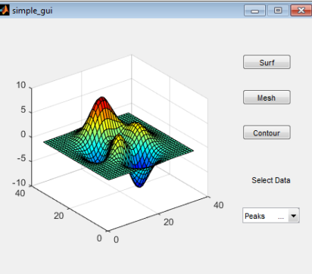
6. Run your code by typing simple_gui2 at the command line. You can select a data set in the pop-up menu and
click the push buttons, but nothing happens. This is because there is no callback code in the file to service the pop-up menu or the buttons.

Slide 7
In the pop-up menu, select Membrane, and then click the Mesh button. The UI displays a mesh plot of the MathWorks L-shaped Membrane logo.Try other combinations before closing the UI. Type help simple_gui2 at the command line. MATLAB software displays the help text.

