Slide 2
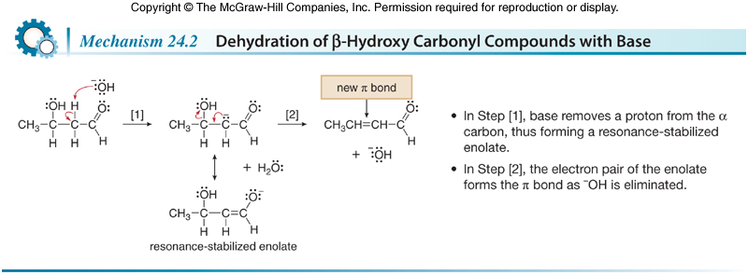
Carbonyl Condensation Reactions
The Aldol Reaction
The mechanism of dehydration consists of two steps: deprotonation followed by loss of ¯OH.

Slide 3
Carbonyl Condensation Reactions
The Aldol Reaction
The elimination reaction that results in the dehydration proceeds via an E1cB mechanism.
The E1cB mechanism differs from the E1 and E2 mechanisms.
Like the E1 elimination, E1cB requires two steps. Unlike E1 though, the intermediate in E1cB is a carbanion, not a carbocation.
E1cB stands for Elimination, unimolecular, conjugate base.
Regular alcohols dehydrate only in the presence of acid, not base, because hydroxide is a poor leaving group. However, when the hydroxy group is β to a carbonyl, loss of H and OH from the α and β carbons forms a conjugated double bond, and the stability of the conjugated system makes up for having such a poor leaving group.
Dehydration of the initial β-hydroxy carbonyl compound drives the equilibrium of an aldol reaction to the right, thus favoring product formation.

