Slide 1
Chapter One

Slide 2
Introduction
Distributed database system (DDBS) technology is the union of what appear to be two diametrically opposed approaches to data processing: database system and computer network technologies.
Database systems have taken us from a paradigm of data processing in which each application defined and maintained its own data (Figure 1.1) to one in which the data are defined and administered centrally (Figure 1.2).

Slide 3
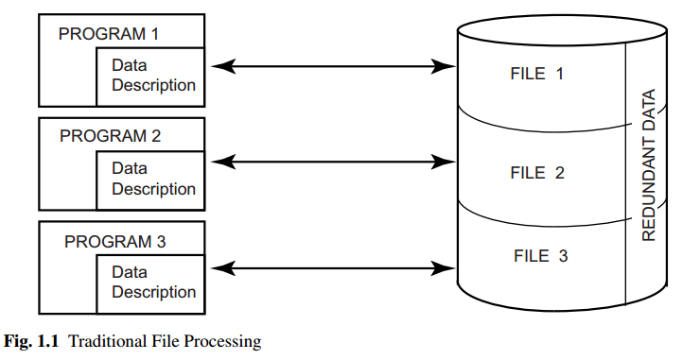

Slide 4
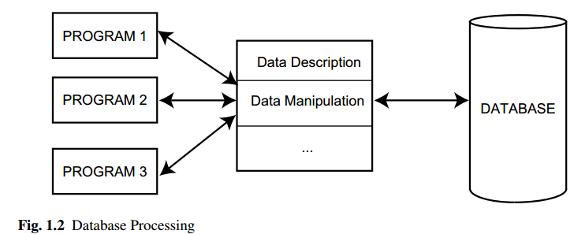

Slide 5
Distributed Data Processing
The term distributed processing (or distributed computing) is hard to define precisely. Obviously, some degree of distributed processing goes on in any computer system, even on single-processor computers where the central processing unit (CPU) and input/output(I/O) functions are separated and overlapped.
This separation and overlap can be considered as one form of distributed processing.

Slide 6
Distributed Data Processing
A fundamental question that needs to be asked is: What is being distributed:
One of the things that might be distributed is the processing logic.
Another possible distribution is according to function.
A third possible mode of distribution is according to data.
Finally, control can be distributed. The control of the execution of various tasks might be distributed instead of being performed by one computer system

Slide 7
What is a Distributed Database System
We define a distributed database :as a collection of multiple, logically interrelated databases distributed over a computer network.
A distributed database management system (distributed DBMS) : is then defined as the software system that permits the management of the distributed database and makes the distribution transparent to the users.

Slide 8
What is a Distributed Database System
Sometimes “distributed database system” (DDBS) is used to refer jointly to the distributed database and the distributed DBMS.
The two important terms in these definitions are “logically interrelated” and “distributed over a computer network.” They help eliminate certain cases that have sometimes been accepted to represent a DDBS.

Slide 9
What is a Distributed Database System
A DDBS is also not a system where, despite the existence of a network, the database resides at only one node of the network (Figure 1.3).
In this case, the problems of database management are no different than the problems encountered in a centralized database environment.
The database is centrally managed by one computer system (site 2 in Figure 1.3) and all the requests are routed to that site. But What we are interested in is an environment where data are distributed among a number of sites (Figure 1.4).

Slide 10
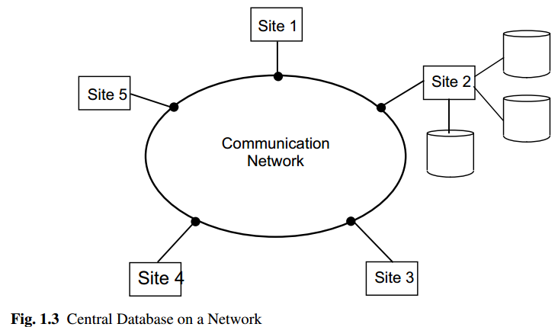

Slide 11
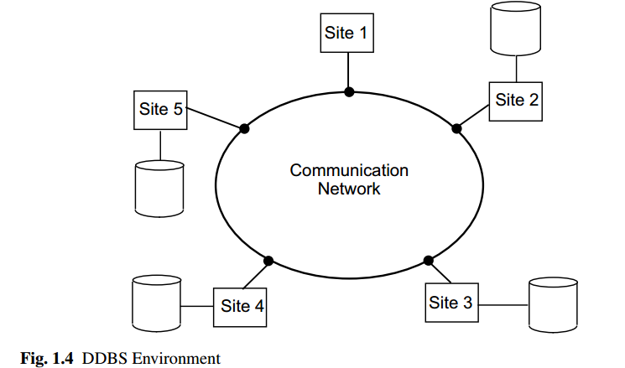

Slide 12
Data Delivery Alternatives
In distributed databases, data are “delivered” from the sites where they are stored to where the query is posed. The alternative delivery modes are: pull-only, push-only and hybrid.
1. In the pull-only mode of data delivery, the transfer of data from servers to clients is initiated by a client pull. When a client request is received at a server, the server responds by locating the requested information.
The main characteristic of pull-based delivery is that the arrival of new data items or updates to existing data items are carried out at a server without notification to clients unless clients explicitly poll the server.

Slide 13
Data Delivery Alternatives
2. In the push-only mode of data delivery, the transfer of data from servers to clients is initiated by a server push in the absence of any specific request from clients.
In push-based mode, servers disseminate information to either an unbounded set of clients (random broadcast) who can listen to a medium or selective set of clients (multicast), who belong to some categories of recipients that may receive the data.

Slide 14
Data Delivery Alternatives
3. The hybrid mode of data delivery combines the client-pull and server-push mechanisms.
The continuous (or continual) query approach presents one possible way of combining the pull and push modes: namely, the transfer of information from servers to clients is first initiated by a client pull (by posing the query), and the subsequent transfer of updated information to clients is initiated by a server push.

Slide 15
Data Delivery Alternatives
There are Three typical frequency measurements that can be used to classify the regularity of data delivery. They are:
periodic, : In periodic delivery, data are sent from the server to clients at regular intervals.
conditional, In conditional delivery, data are sent from servers whenever certain conditions installed by clients in their profiles are satisfied.
Irregular: Ad-hoc delivery is irregular and is performed mostly in a pure pull-based system. Data are pulled from servers to clients in an ad-hoc fashion whenever clients request it.

Slide 16
Promises of DDBSs
In this section we discuss these promises and, in the process, introduce many of the concepts that we will study in subsequent chapters.
Transparent Management of Distributed and Replicated Data
Transparency refers to separation of the higher-level semantics of a system from lower-level implementation issues. In other words, a transparent system “hides” the implementation details from users.
The advantage of a fully transparent DBMS is the high level of support that it provides for the development of complex applications.

Slide 17
Let us start our discussion with an example. Consider an engineering firm that has offices in Boston, Waterloo, Paris and San Francisco. They run projects at each of these sites and would like to maintain a database of their employees, the projects and other related data.
Assuming that the database is relational, we can store this information in two relations: EMP(ENO, ENAME, TITLE)1 and PROJ(PNO, PNAME, BUDGET).
We also introduce a third relation to store salary information: SAL(TITLE, AMT) and a fourth relation ASG which indicates which employees have been assigned to which projects for what duration with what responsibility: ASG(ENO, PNO, RESP, DUR).

Slide 18
If all of this data were stored in a centralized DBMS, and we wanted to find out the names and employees who worked on a project for more than 12 months, we would specify this using the following SQL query:
SELECT ENAME, AMT
FROM EMP, ASG, SAL
WHERE ASG.DUR > 12
AND EMP.ENO = ASG.ENO AND SAL.TITLE = EMP.TITLE

Slide 19
Thus, what we are engaged in is a process where we partition each of the relations and store each partition at a different site.
This is known as fragmentation. Furthermore, it may be preferable to duplicate some of this data at other sites for performance and reliability reasons.
The result is a distributed database which is fragmented and replicated.

Slide 20
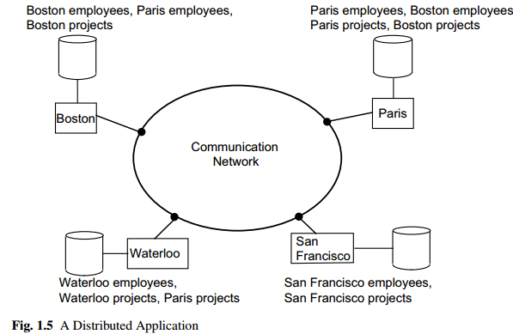

Slide 21
Reliability Through Distributed Transactions
Distributed DBMSs are intended to improve reliability since they have replicated components and, thereby eliminate single points of failure.
The failure of a single site, or the failure of a communication link which makes one or more sites unreachable, is not sufficient to bring down the entire system.
In the case of a distributed database, this means that some of the data may be unreachable, but with proper care, users may be permitted to access other parts of the distributed database.

Slide 22
The “proper care” comes in the form of support for distributed transactions and application protocols.
A transaction is a basic unit of consistent and reliable computing, consisting of a sequence of database operations executed as an atomic action.
It transforms a consistent database state to another consistent database state even when a number of such transactions are executed concurrently (sometimes called concurrency transparency), and even when failures occur (also called failure atomicity).

Slide 23
Improved Performance
The case for the improved performance of distributed DBMSs is typically made based on two points. First, a distributed DBMS fragments the conceptual database, enabling data to be stored in close proximity to its points of use (also called data localization). This has two potential advantages:
1. Since each site handles only a portion of the database, contention for CPU and I/O services is not as severe as for centralized databases.
2. Localization reduces remote access delays that are usually involved in wide area networks (for example, the minimum round-trip message propagation delay in satellite-based systems is about 1 second).
Most distributed DBMSs are structured to gain maximum benefit from data localization. Full benefits of reduced contention and reduced communication overhead can be obtained only by a proper fragmentation and distribution of the database.

Slide 24
Easier System Expansion
In a distributed environment, it is much easier to accommodate increasing database sizes. Major system overhauls are seldom necessary; expansion can usually be handled by adding processing and storage power to the network.
One aspect of easier system expansion is economics. It normally costs much less to put together a system of “smaller” computers with the equivalent power of a single big machine.

Slide 25
Design Issues
1.Distributed Directory Management
A directory contains information about data items in the database. Problems related to directory management are similar in nature to the database placement problem discussed in the preceding section.
A directory may be global to the entire DDBS or local to each site; it can be centralized at one site or distributed over several sites; there can be a single copy or multiple copies.

Slide 26
2.Distributed Query Processing
Query processing deals with designing algorithms that analyze queries and convert them into a series of data manipulation operations.
The problem is how to decide on a strategy for executing each query over the network in the most cost-effective way, however cost is defined. The factors to be considered are the distribution of data, communication costs, and lack of sufficient locally-available information.
The objective is to optimize where the inherent parallelism is used to improve the performance of executing the transaction, subject to the above-mentioned constraints. The problem is NP-hard in nature, and the approaches are usually heuristic.

Slide 27
3. Distributed Concurrency Control
Concurrency control involves the synchronization of accesses to the distributed database, such that the integrity of the database is maintained.
The concurrency control problem in a distributed context is somewhat different than in a centralized framework.
The condition that requires all the values of multiple copies of every data item to converge to the same value is called mutual consistency.

Slide 28
4. Distributed Deadlock Management
The deadlock problem in DDBSs is similar in nature to that encountered in operating systems. The competition among users for access to a set of resources (data, in this case) can result in a deadlock if the synchronization mechanism is based on locking.
The well-known alternatives of prevention, avoidance, and detection/recovery also apply to DDBSs.

Slide 29
5. Reliability of Distributed DBMS
We mentioned earlier that one of the potential advantages of distributed systems is improved reliability and availability. This, however, is not a feature that comes automatically.
It is important that mechanisms be provided to ensure the consistency of the database as well as to detect failures and recover from them. The implication for DDBSs is that when a failure occurs and various sites become either inoperable or inaccessible, the databases at the operational sites remain consistent and up to date.
Furthermore, when the computer system or network recovers from the failure, the DDBSs should be able to recover and bring the databases at the failed sites up-to-date.

Slide 30
Distributed DBMS Architecture
In this section we develop three “reference” architectures2 for a distributed DBMS: client/server systems, peer-to-peer distributed DBMS, and multidatabase systems.
We then have a short discussion of a generic architecture of a centralized DBMSs, that we subsequently extend to identify the set of alternative architectures for a distributed DBMS. Within this characterization, we focus on the three alternatives that we identified above.

Slide 31
ANSI/SPARC Architecture
A simplified version of the ANSI/SPARC architecture is depicted.
There are three views of data: the external view, which is that of the end user, who might be a programmer; the internal view, that of the system or machine; and the conceptual view, that of the enterprise.
For each of these views, an appropriate schema definition is required. At the lowest level of the architecture is the internal view, which deals with the physical definition and organization of data.
The location of data on different storage devices and the access mechanisms used to reach and manipulate data are the issues dealt with at this level.

Slide 32
At the other extreme is the external view, which is concerned with how users view the database.
An individual user’s view represents the portion of the database that will be accessed by that user as well as the relationships that the user would like to see among the data.
A view can be shared among a number of users, with the collection of user views making up the external schema. In between these two ends is the conceptual schema, which is an abstract definition of the database.

Slide 33
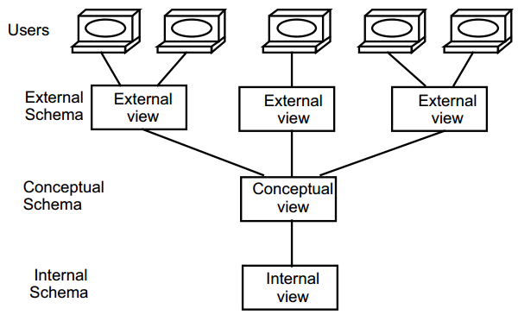
The ANSI/SPARC Architecture

Slide 34
2. A Generic Centralized DBMS Architecture
The functions performed by a DBMS can be layered as in Figure 1.7, where the arrows indicate the direction of the data and the control flow.
Taking a top-down approach, the layers are the interface, control, compilation, execution, data access, and consistency management. The interface layer manages the interface to the applications.

Slide 35
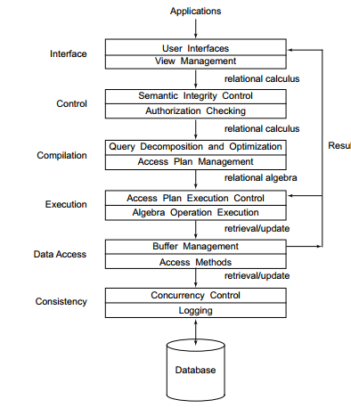
Functional Layers of a Centralized DBMS

Slide 36
3. Client/Server Systems
This architecture, depicted in Figure 1.8, is quite common in relational systems where the communication between the clients and the server(s) is at the level of SQL statements.
In other words, the client passes SQL queries to the server without trying to understand or optimize them. The server does most of the work and returns the result relation to the client. There are a number of different types of client/server architecture.
The simplest is the case where there is only one server which is accessed by multiple clients. We call this multiple client/single server. Figure 1.9 illustrates a simple view of the database server approach, with application servers connected to one database server via a communication network.

Slide 37
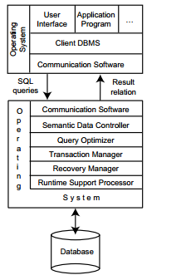
Client/Server Reference Architecture

Slide 38
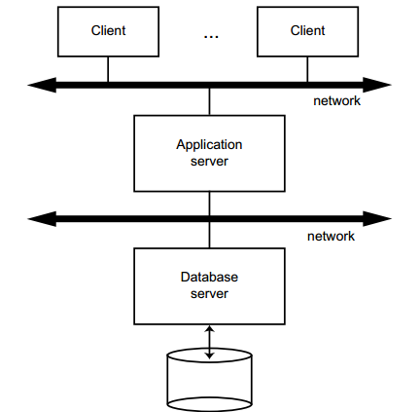
Database Server Approach

Slide 39
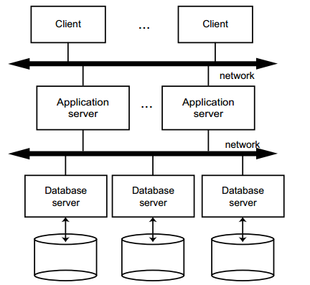
Distributed Database Servers

