Slide 1
Carboxylic Acids
Carboxylic acids are protected for a number of reasons:
1- to mask the acidic proton so that it does not interfere with base-catalyzed reactions,
2- to mask the carbonyl group to prevent nucleophilic addition reactions.
3- to improve the handling of the molecule in question (e.g., to make the compound less water soluble, to improve its NMR characteristics, or to make it more volatile so that it can be analyzed by gas chromatography).
protective group must also be removed without affecting other functionality in the molecule.
1- Esters
( alkyl ester )Formation : - Fisher esterification (RCOOH +R'OH + H+) - Acid Chloride + R-OH, pyridine - t-butyl esters: isobutylene and acid -methyl esters: diazomethane
-RCO2H, R'OH, DCC/DMAP, Et2O,

Slide 2
Cleavage: - LiOH, THF, H2O - enzymatic hydrolysis
- t-butyl esters are cleaved with aqueous acid

Slide 3
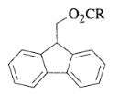
9-Fluorenylmethyl Esters (Fm)
9-Fluorenylmethyl esters of N-protected amino acids were prepared using the DCC/DMAP
imidazole-catalyzed transesterification of protected amino acid active esters with FmOH. Cleavage is accomplished
either with diethylamine or piperidine in CH2C12 at rt for 2 h. No racemization was observed during formation
or cleavage of the Fm esters. The Fm ester is cleaved slowly by hydrogenolysis, but complete selectivity for
hydrogenolysis of the benzyloxycarbonyl group could not be obtained.
Fm esters also improved the solubility of protected peptides in organic solvents.
cleaved with mild base (Et2NH, piperidine)
Methoxymethyl (MOM) Ester: RCOOCH2OCH3
1. CH3OCH2C1, Et3N, DMF, 25°, 1 h.1
2. CH3OCH2OCH3, Zn/BrCH2CO2Et, 0°; CH3COC1, 0-20°, 2 h, 75-85%.2 A
number of methoxymethyl esters were prepared by this method, which
avoids the use of the carcinogen chloromethyl methyl ether.

Slide 4
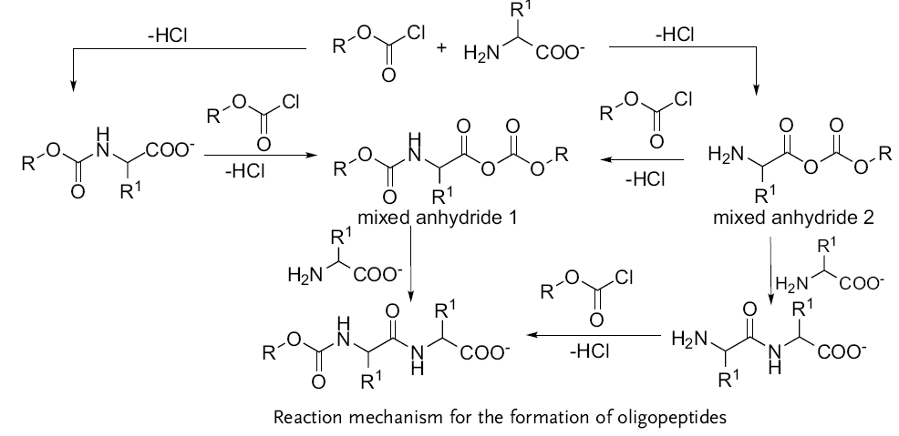

Slide 5
Trimethylsilyl)ethoxymethyl Ester (SEM)
The SEM ester was used to protect a carboxyl group where DCC-mediated esterification caused destruction of the substrate. It was formed from the acid and SEM chloride
SEM groups are cleaved by treatment with fluoride ion.
Trimethylsilyl)ethyl Esters

Slide 6
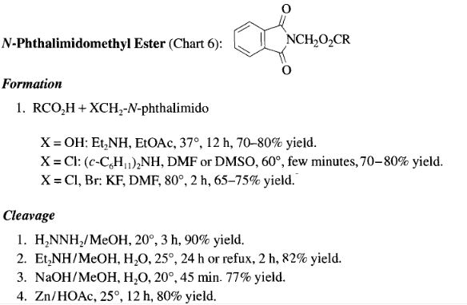

Slide 7
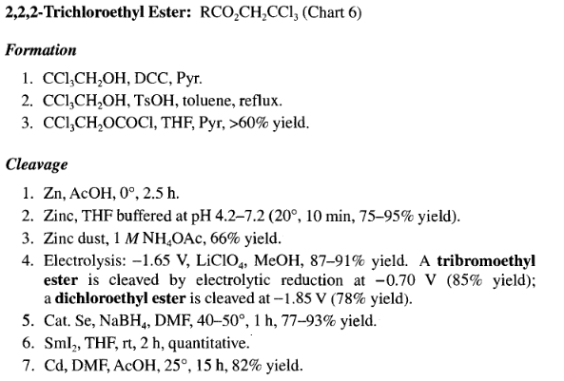

Slide 8
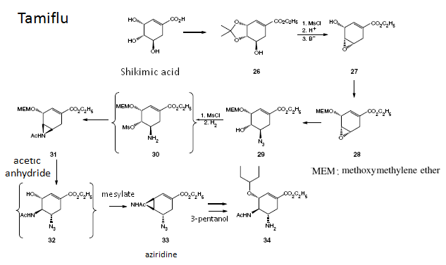

Slide 9
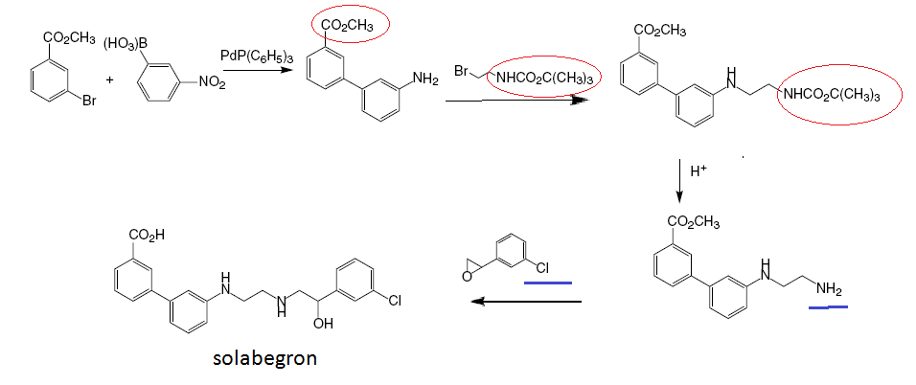

Slide 10
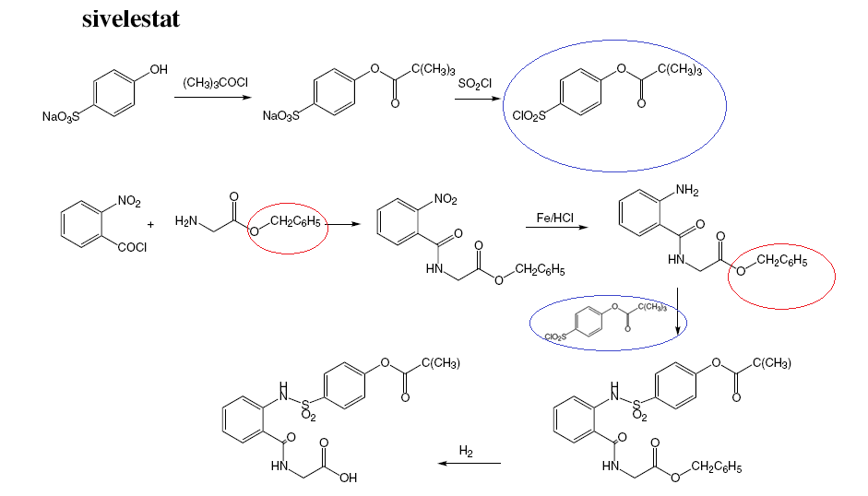

Slide 11
