Slide 1
Protection amino groups
A great many protective groups have been developed for the amino group, including
1- carbamates (-NCO₂R), used for the protection of amino acids in peptide and protein syntheses. Carbamates are formed from an amine with a wide variety of reagents, the chloroformate being the most common .
n-Alkyl carbamates are cleaved by acid-catalyzed hydrolysis.
2-amides (-NCOR), used more widely in syntheses of alkaloids and for the protection of the nitrogen bases adenine, cytosine, and guanine in nucleotide syntheses.
amides are formed from the acid chloride.
N-alkylamides are cleaved by acidic or basic hydrolysis at reflux and by ammonolysis conditions that cleave peptide bonds.

Slide 2
CARBAMATES
Carbamates can be used as protective groups for amino acids to minimize racemization in peptide synthesis. Many carbamates have been used as protective groups. The most useful compounds (not necessarily the simplest structures) are
a) t-butyl (BOC), readily cleaved by acidic hydrolysis;
b) benzyl (Cbz or Z), cleaved by catalytic hydrogenolysis,
c) 2,4-dichlorobenzyl, stable to the acid-catalyzed hydrolysis of benzyl and t-butyl carbamates;
d) 2-(biphenylyl)isopropyl, cleaved more easily than t-butyl carbamate by dilute acetic acid. E) 9-fluorenylmethyl, cleaved by α-elimination with base.
f) isonicotinyl, cleaved by reduction with zinc in acetic acid.
g) 1-adamantyl, readily cleaved by trifluoroacetic acid.
h) and allyl, readily cleaved by Pd-catalyzed isomerization.

Slide 3
t-Butyl (BOC) Carbamate: (CH3KCOC(O)NR2
The BOC group is used extensively in peptide synthesis for amine protection.
It is not hydrolyzed under basic conditions and is inert to many other nucleophilic
reagents.
Formation
(B0C)2O, NaOH, H2O, 25°, 10-30 min, 75-95% yield. This is one of the more common methods for introduction of the BOC group. It has the advantage that the by-products are innocuous and easily removed.
2. (BOC)2O, TEA, MeOH or DMF, 40-50°, 87-99% yield. These non aqueous conditions were used in the protection of -labeled amino acids so that the label would not be lost because of exchange with water
3. (BOCJO, EtOH or MeOH, NaHCO3, ultrasound, 84-100% yield.
4. (BOCJO, Me4NOH-5H2O, CH,CN, 88-100% yield. These conditions were found to be very good for sterically hindered amino acids.

Slide 4
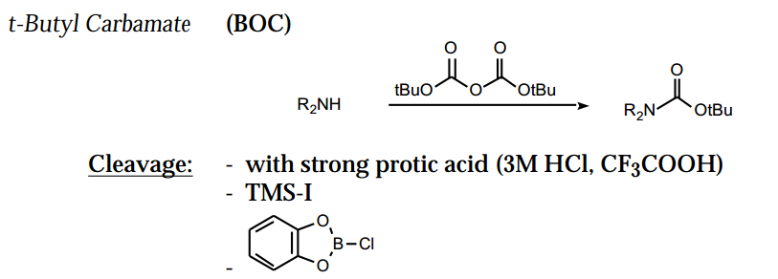
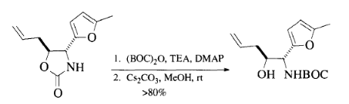


5- Mono protection of small diamines [H₂N(CH₂)nNH₂, [n= 2-6] is achieved by reacting an excess of the amine with (BOC)2O in dioxane (75-90% yield).

Slide 5

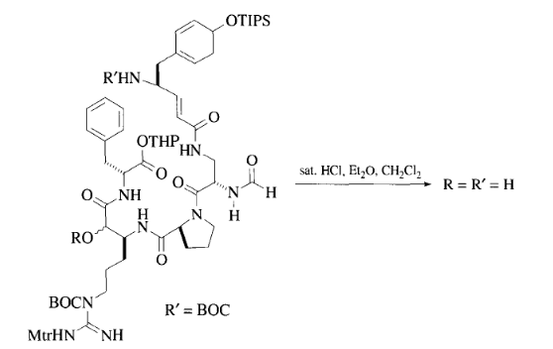
Chloro catecole boran
Or bromo catecole boran
3 M HC1, EtOAc, 25°, 30 min, 96% yield.10 With MeOH as the solvent, a diphenylmethyl ester is not affected.

Slide 6
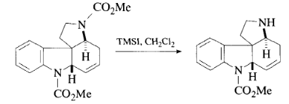
Methyl and Ethyl Carbamate: CH₃OC(O)NR₂
CH₃OCOC1, K₂CO₃, reflux 12 h.
Cleavage
1. n-PrSLi, 0°, 8.5 h, 75-80% yield
2. Me3SiI ,50°, 70% yield.
3. КОН, Н2О, ethylene glycol, 100°, 12 h, 88% yield.
4. HBr, AcOH, 25°, 18 h.
NaOH, MeOH, rt, 80% yield.28 Cleavage occurs under such mild conditions
because the N-O nitrogen in this case is a much better leaving group
than the typical aliphatic amine.

Slide 7

9-Fluorenylmethyl Carbamate (Fmoc-NR2)
One major advantage of the Fmoc protective group is that it has excellent acid stability; thus, BOC and benzyl-based groups can be removed in its presence. Other advantages are that it is readily cleaved, non hydrolytically, by simple amines, and the protected amine is liberated as its free base. The Fmoc group is generally considered to be stable to hydrogenation conditions, but it has been shown that, under some circumstances, it can be cleaved with H2/Pd-C, AcOH, MeOH
Formation
1. Fmoc-Cl, NaHCO3, aq. dioxane, 88-98% yield.3 Diisopropylethylamine is reported to suppress dipeptide formation during Fmoc introduction with Fmoc-Cl.
2. Fmoc-N3, NaHCO3, aq. dioxane, 88-98% yield. This reagent reacts more slowly with amino acids than does the acid chloride. It is not the safest method for Fmoc introduction, because of the azide.
3. Fmoc-OBt (Bt = benzotriazol-1-yl).

Slide 8
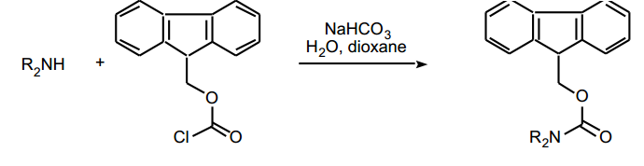
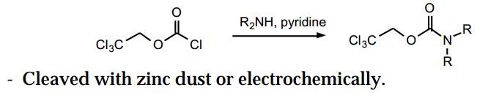
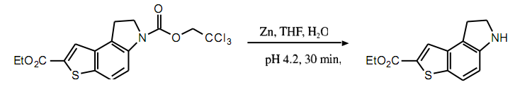
2,2,2-Trichloroethyl Carbamate (Troc-NR2): C13CCH2OC(O)NR2)
Formation
1. Cl3CCH2OCOCl,Pyroraq. NaOH, 25°, 12 h.12
2. Silylate with Me3SiN=C(OSiMe3)CH3, then treat with C13CCH2OCOC1.3
3. Cl3CCH2OCO-O-succinimidyl, 1 N NaOH or 1 N Na2CO3, dioxane, 77-96% yield.4'5 This method does not result in oligopeptide formation when it is used to prepare amino acid derivatives.

Slide 9
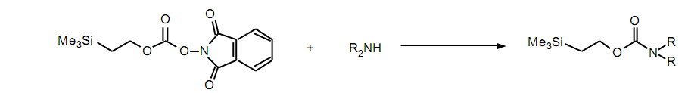
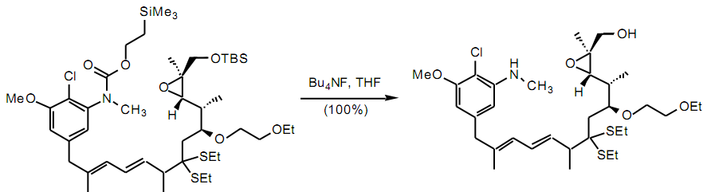

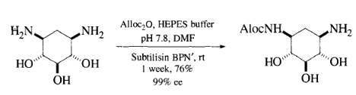
Trimethylsilylethyl Carbamate (Teoc-NR2): (CH3KSiCH2CH2OC(O)NR2
Allyl Carbamate (Aloc-NR2 or Alloc-NR2): CH2=CHCH2OC(O)NR2
Formation
1. CH2=CHCH2OCOC1, Pyr.
2. (CH2=CHCH2OCOJO, dioxane, H2O, reflux or CH2C12, 1 h, rt,
yield.2 3. CH2=CHCH2OC(O)-O-benzotriazolyl.
4. (CH2=CHCH2OCOJO, phosphate buffer pH 8,

Slide 10
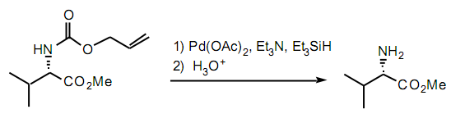

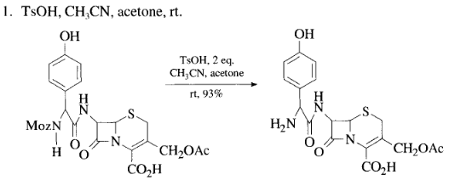
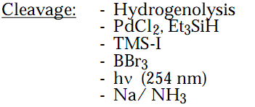
Benzyl Carbamate (Cbz- orZ-NR2): PhCH2OC(O)NR2
Formation
1. PhCH2OCOCl, Na2CO3, H20,0°, 30 min,72% yield.1 Alpha-omega diamines can be protected somewhat selectively with this reagent at a pH between
3.5 and 4.5, but the selectivity decreases as the chain length increases [H2N(CH2)n NH2, n = 2, 71% mono;
n = 7, 29% mono].2 Hindered amino acids are protected in DMSO (DMAP, TEA, heat, 47-82% yield). These
conditions also convert a carboxylic acid to the benzyl ester.
2. PhCH2OCOCl, MgO, EtOAc, 3 h, 70° to reflux, 60% yield.
3. (PhCH2OCOJO, dioxane, H2O, NaOH or Et3N.56 This reagent was to give better yields in preparing amino acid derivatives than when PhCH2OCOCl was used. The reagent decomposes at 50°.
Methoxy benzyl carbamate Moz

Slide 11


AMIDES
Simple amides are generally prepared from the acid chloride or the anhydride. They are exceptionally stable to acidic or basic hydrolysis and are classically hydrolyzed by brute force by heating in strongly acidic or basic solutions.
hydrolytic stability increases from formyl to acetyl to benzoyl. Lability of the haloacetyl derivatives to mild acid hydrolysis increases with substitution:
acetyl < chloroacetyl < dichloroacetyl < trichloroacetyl < trifluoroacetyl
Formamide: R₂NCHO
Formation
1. 98% HCO2H, Ac2O, 25°, 1 h, 78-90% yield.12 The use of formic acetic anhydride for esterification and amide formation has been reviewed.
2. HCO2H, DCC, Pyr, 0°, 4 h, 87-90% yield.4 These conditions produce N-formyl derivatives of f-butyl amino acid esters with a minimum of racemization.
Cleavage
1. HC1, H2O, dioxane, 25°, 48 h, or reflux, 1 h, 80-95% yield.1
2. Hydrazine, EtOH, 60°, 4 h, 60-80% yield.15
Acetamide: R2NAc
Formation
The simplest method for acetamide preparation involves reaction of the amine
with acetic anhydride or acetyl chloride with or without added base.

Slide 12
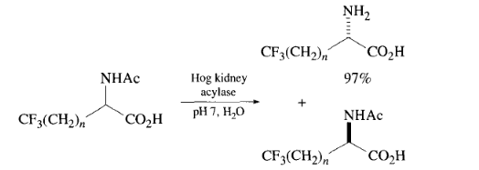
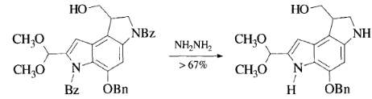
Cleavage
1. 1.2 N HC1, reflux, 9 h, 61-77% yield.
2. 85% Hydrazine, 70°, 15 h, 68% yield.
3. Et3O+BF4", CH2C12, 25°, 1-2 h, 90% yield, then aq. NaHCO3, satisfactory yields.
4. Hog kidney acylase, pH 7, H2O, 36°, 35 h.1112 In this case, deprotection also proceeds with resolution, since only one enantiomer is cleaved.
Benzamide: R₂NCOC6H5
Formation
1. PhCOCl, Pyr, 0°, high yield.
2. PhCOCN, CH2C12, -10°, 92% yield.2 This reagent readily acylates amines in the presence of alcohols.
3. PhCOCF(CF3)2, Me2NCH2CH2NMe2 (TMEDA), 25°, 30 min, high yield.
Cleavage
6 N HC1, reflux, 48 h or HBr, AcOH, 25°, 72 h, 80% yield.
Hydrazine, EtOH,

Slide 13

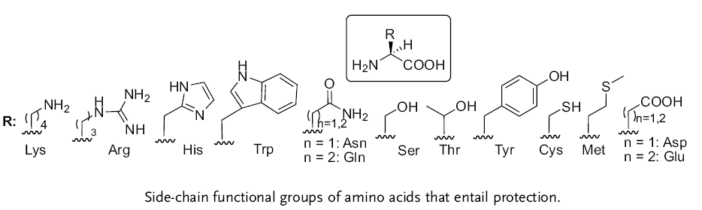
Cyclic Imide Derivatives
Formation
1. Phthalic anhydride, CHC13, 70°, 4 h, 85-93% yield.
2. Phthalic anhydride, TaCl,-SiO2, 5 min, 88-92% yield.
3. Phthalic anhydride, HMDS, rt, 1 h, then reflux with ZnBr2 1 h, 94% yield.
Cleavage
1. Hydrazine, EtOH, 25°, 12 h; H30+, 76% yield.412
2. PhNHNH2, n-Bu3N, reflux, 2 h, 83% yield.13
3. Na2S.H2O, H20, THF, 68-90% yield; DCC(—H2O), 67-97% yield;
( hydrazine; dil. HC1, 55-95% yield.This method is used to cleave N- phthalimido penicillins; hydrazine attacks an intermediate phthalisoimide instead of the azetidinone ring. )
Protecting amino acid groups

Slide 14
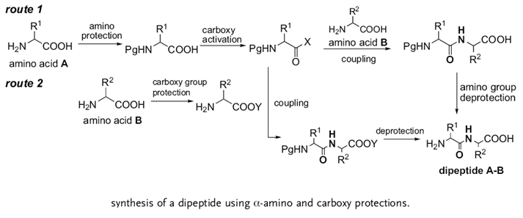
α-Amino Protection
The α-amino group is protected to reduce its nucleophilicity.
The α-amino protections are of different types and they can be categorized using different
approaches. However, based on the criteria of the magnitude of the present utility of each type,
the groups can be classified into non-urethane- and urethane-type N^{α} protections.

Slide 15
Non-Urethanes
Acyl Type
Reaction of amino acids with alkyl or aryl carboxylic acid derivatives
N-acyl amines or amides.Acyl groups were the first generation of N^{α}-protecting
groups used for peptide synthesis. The necessity for the protection of the N^{α}-amino
group for successful peptide synthesis
The acyl groups present two synthetic difficulties in general – difficulty in the
removal of the group without destroying the meticulously assembled peptide bonds
and a high degree of racemization of N^{α}-acyl-protected amino acid derivatives.
Trifluoroacetyl (Tfa) Group
Tfa is of special interest as a mono acyl-type protecting group.
Due to the negative inductive effect of the -CF3 substitution,
the trifluoroacetamides readily undergo hydrolysis in mild alkaline
conditions to which peptide bonds and most carboxy esters are largely stable,
Optically pure Na-Tfa-amino acids are prepared by treating amino acids
trifluoroacetic anhydride (TFAA) in anhydrous trifluoroacetic acid (TFA) solvent at -10 to +10 Cº .
method can also be successfully used to obtain N^{α} -Tfa-Lys/Orn from Lys/Orn.

Slide 16
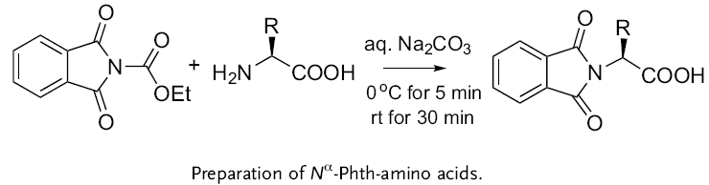
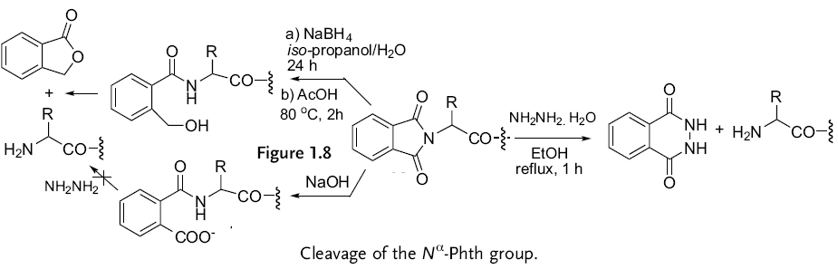
Phthaloyl (Phth) Group
N^{α} -Protected Phth-amino acids 12 are prepared under mild and racemization-free
conditions by using phthaloylating reagents
The N^{α} -Phth group is normally removed by means of hydrazinolysis by treatment
with hydrazine hydrate in refluxing MeOH or EtOH,
Alternatively, a two-step procedure, which involves a reductive ring opening,
followed by an acid-catalyzed lactonization of the resulting hydroxy compound
Phth protection cannot be removed by treatment with alkali. The alkali opens the five membered ring
to a mono acyl amide of phthalic acid, which is stable to hydrazine and to bases

Slide 17
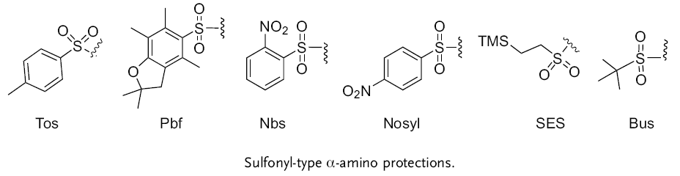
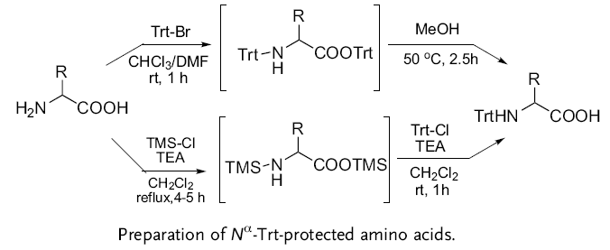
Sulfonyl-Type Groups
Reaction of amino acids with aryl/alkyl sulfonic acid derivatives yields the corresponding sulfonamides.
The 4-toluenesulfonyl (tosyl or Ts) group, only method of cleavage is reduction with sodium in liquid NH₃
Triphenylmethyl (Trityl or Trt) Group Na-Trt-amino acids 31 can be prepared by treating amino acid methyl esters with Trt-Cl followed by alkaline hydrolysisof the ester. Hydrolysis is rather sluggish due to steric hindrance by the Trt group
Trt= Triphenylmethy

Slide 18
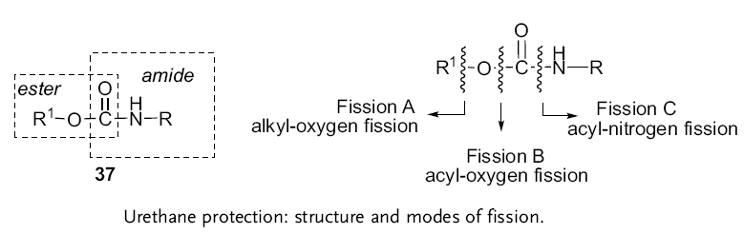
Urethanes (Carbamates or Alkyloxycarbonyl Groups)
9-Fluorenylmethoxycarbonyl (Fmoc) Group
The group is completely stable to acids and to a large extent to catalytic hydrogenation, although prolonged catalytic hydrogenation can cleave the group (this surprising reactivity of Fmoc to catalytic hydrogenation has been attributed to the β-phenylethyloxy skeleton that can be fragmented through hydrogenolysis,
Preparation:
9-Fluorenylmethyl chloroformate (Fmoc-Cl) and Fmoc-Cl are the favored reagents for introducing the Fmocgroup. Fmoc-Cl is commercially vailable (also prepared by the action of phosgene on 9-fluorenyl methanol) and storable for a long time under anhydrous conditions at low temperature.
Cleavage:
The Fmoc group is deblocked by nonhydrolytic base treatment by a variety of organic amines, but most efficiently by unhindered cyclic amines such as piperidine and morpholine in polar solvents such as DMF.

Slide 19
